Slide 1
GeConT (Gene Context Tool)
The web application, which allows users to visualize the genomic context of a gene or a group of genes and their orthologous.
The server incorporates information from the COG, Pfam and KEGG databases, allowing users to have an integrated graphical representation of the function of genes at multiple levels, their phylogenetic distribution and their genomic context.

Slide 2
GeConT
http://operons.ibt.unam.mx/gctNG/

Slide 3
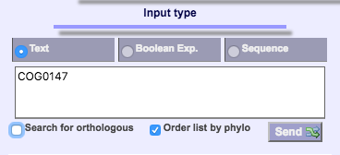
How to use GeConT
Help is available at http://operons.ibt.unam.mx/gctNG/help.jsp
(To explain very briefly) Input the information and put “send” button.

Slide 4
Input
The example of the input is in the right figure.
User can input many type of information.

Slide 5
Options
There is 4 options. Please read the help for the description of each.

Slide 6
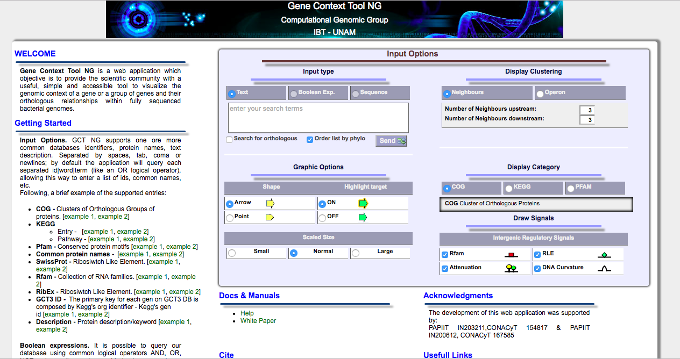
Tutorial
User can learn how to use this web site by the “Getting Started

Slide 7
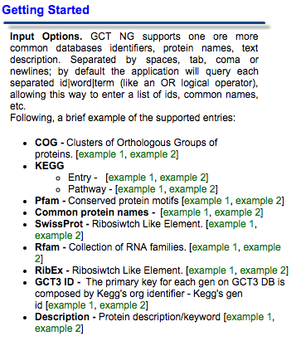
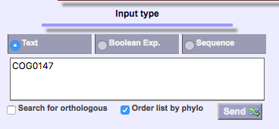
Tutorial
1. choose the example1 or example2 (green) (the left figure)
2. text is filled. user only should put “send” button (the right figure)

Slide 8
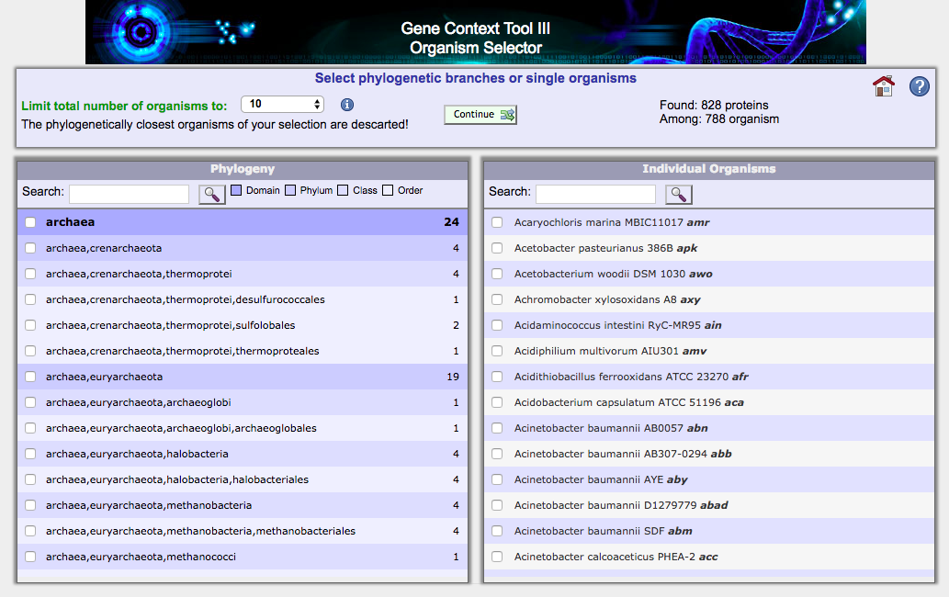
Organism selector
The next window is “Organism selector”
Check the box of desired phylogeny selection (left side) or desired species (right side).
If the phylogeny section is checked (left side), species included in that phylogeny section is automatically checked (right side)
To continue the analysis, put the “continue” button.

Slide 9
Output
The example of the output (search word : trpE)
The pathway including trpE is displayed.

Slide 10
FIDEA
A server for the functional interpretation of differential expression analysis.

Slide 11
How to use
1. select species
2. upload the DE (differential expression) analysis results
3. change the p-value
(by default 0.05)
4. select whole genome or personalized gene list
5. submit

Slide 12
Example of file to upload

Slide 13
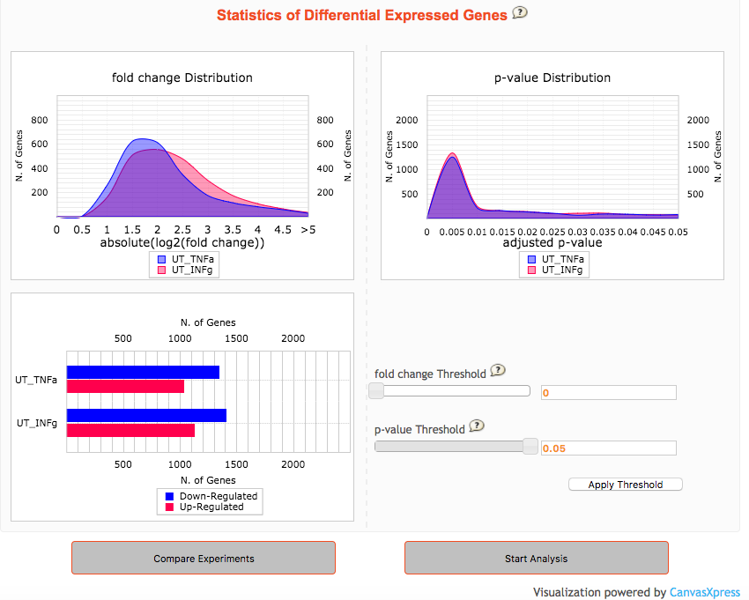
Preliminary statistics
Left : about differential expressed genes
Right : including some figures (↓)
A graph reporting the distribution of the absolute values of log2 fold changes for each experiment
A graph reporting the distribution of the p-values for each experiment
A graph reporting the number of differentially expressed genes for each experiment

Slide 14
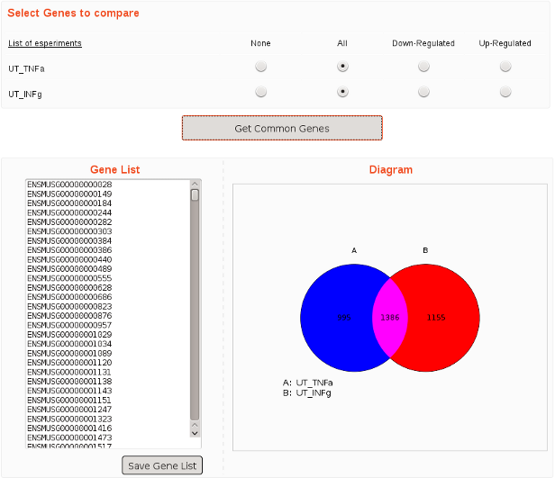
Compare different experiments
The figure shows the numbers of genes
Blue : in experminet1 Red : in experminet2
Pink : in both experiment
expression was changed

Slide 15
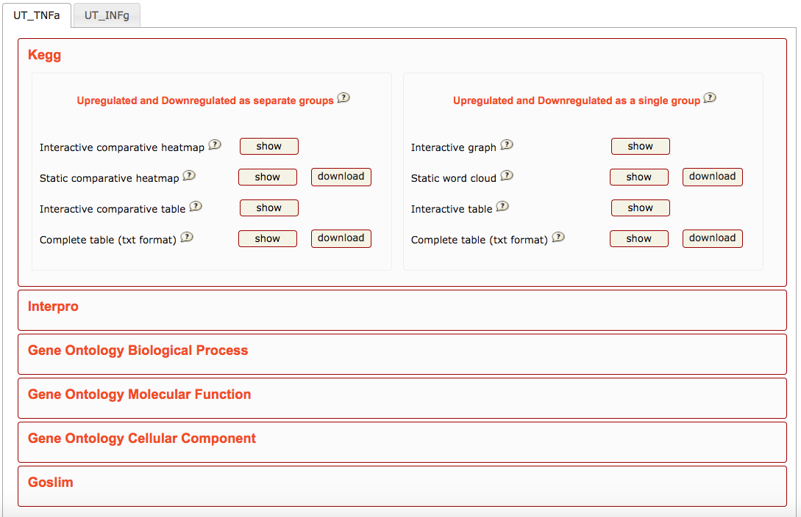
Functional characterization results
Including many functions (right figure)

Slide 16
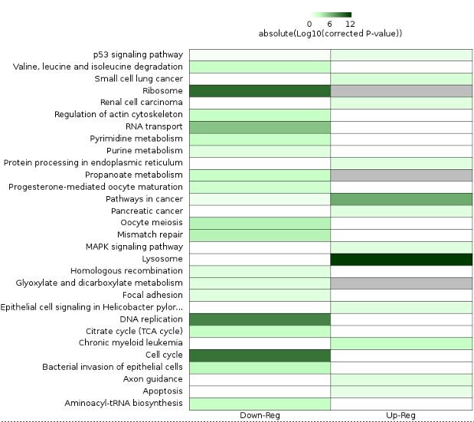
1. gene group expressions
The "Upregulated and Downregulated as separate groups" analysis produces a heatmap showing the differences among the corrected p-values of upregulated genes and downregulated genes.

Slide 17
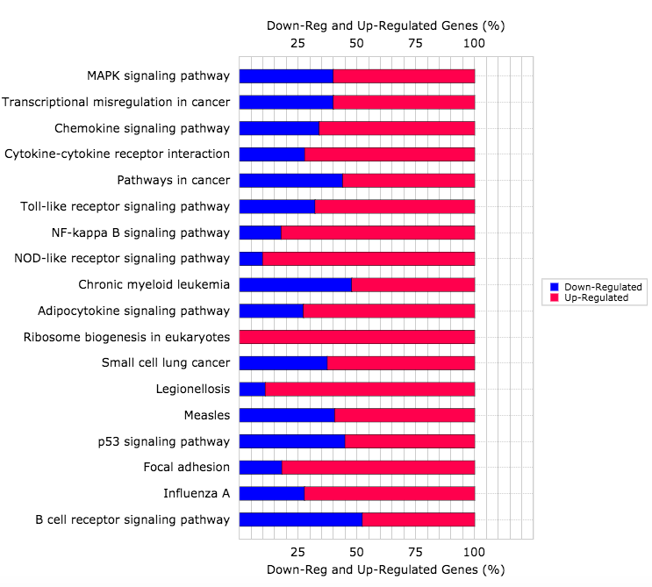
2. gene expressions
The "Upregulated and Downregulated as a single group" analysis produces a heatmap showing if gene are down-regulated or up-regulated for each pathways.

