Slide 1
pcot2
The package of R for the analysis of groups of genes in microarray experiments.
It can investigate gene interactions.
Currently it can be applied to 2-sample comparisons
It has below functions
pcot2
corplot, corplot2 (almost same functions)
aveProbe

Slide 2
The pcot2 function
Test changes in activity in pre-specified gene sets
Requires 3 arguments
1. gene expression data matrix
2. sample class labels (in the form of vector, sample class is currently only 2)
3. gene category indicator matrix

Slide 3
1. gene expression data matrix
rows:genes columns:samples
values:expression of genes for each gene for each sample

Slide 4
2. sample class labels
Represent two distinct experimental conditions. (This pcot2 is used for 2-sample comparison)
Example : 0 0 0 0 0 1 1 1 1 1
Gene expression matrix is below
In the below case, sample 1-5 are same condition, and sample 6-10 are same condition.

Slide 5
3. gene category indicator matrix
rows:genes columns:pathways values:if the gene contained in the pathway (0 or 1)

Slide 6
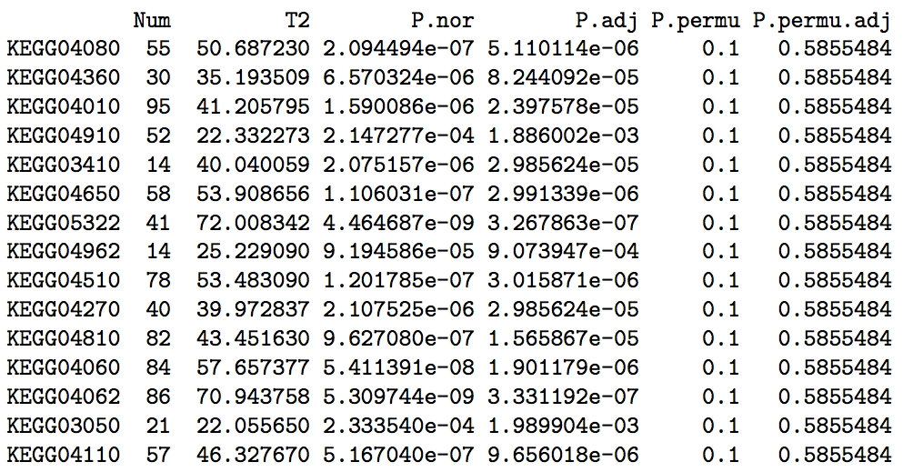
Result of pcot2 function
Num is the number of genes included in the pathway.
T2 is Hotelling’s T 2 statistic.
If this score are bigger, gene expression changes are detected between 2 experiment conditions.

Slide 7
The corplot function
This function visualize both correlation and gene expression information for a particular gene category.
Requires 3 arguments
1. gene expression data (matrix)
2. selected gene identifiers (vector)
3. sample class labels (vector, representing two distinct experimental conditions)
1,3 is same as pcot2 function.

Slide 8
2. selected gene identifiers
A vector of gene names
In this case, detect the correlation and gene expression information for only these genes.

Slide 9
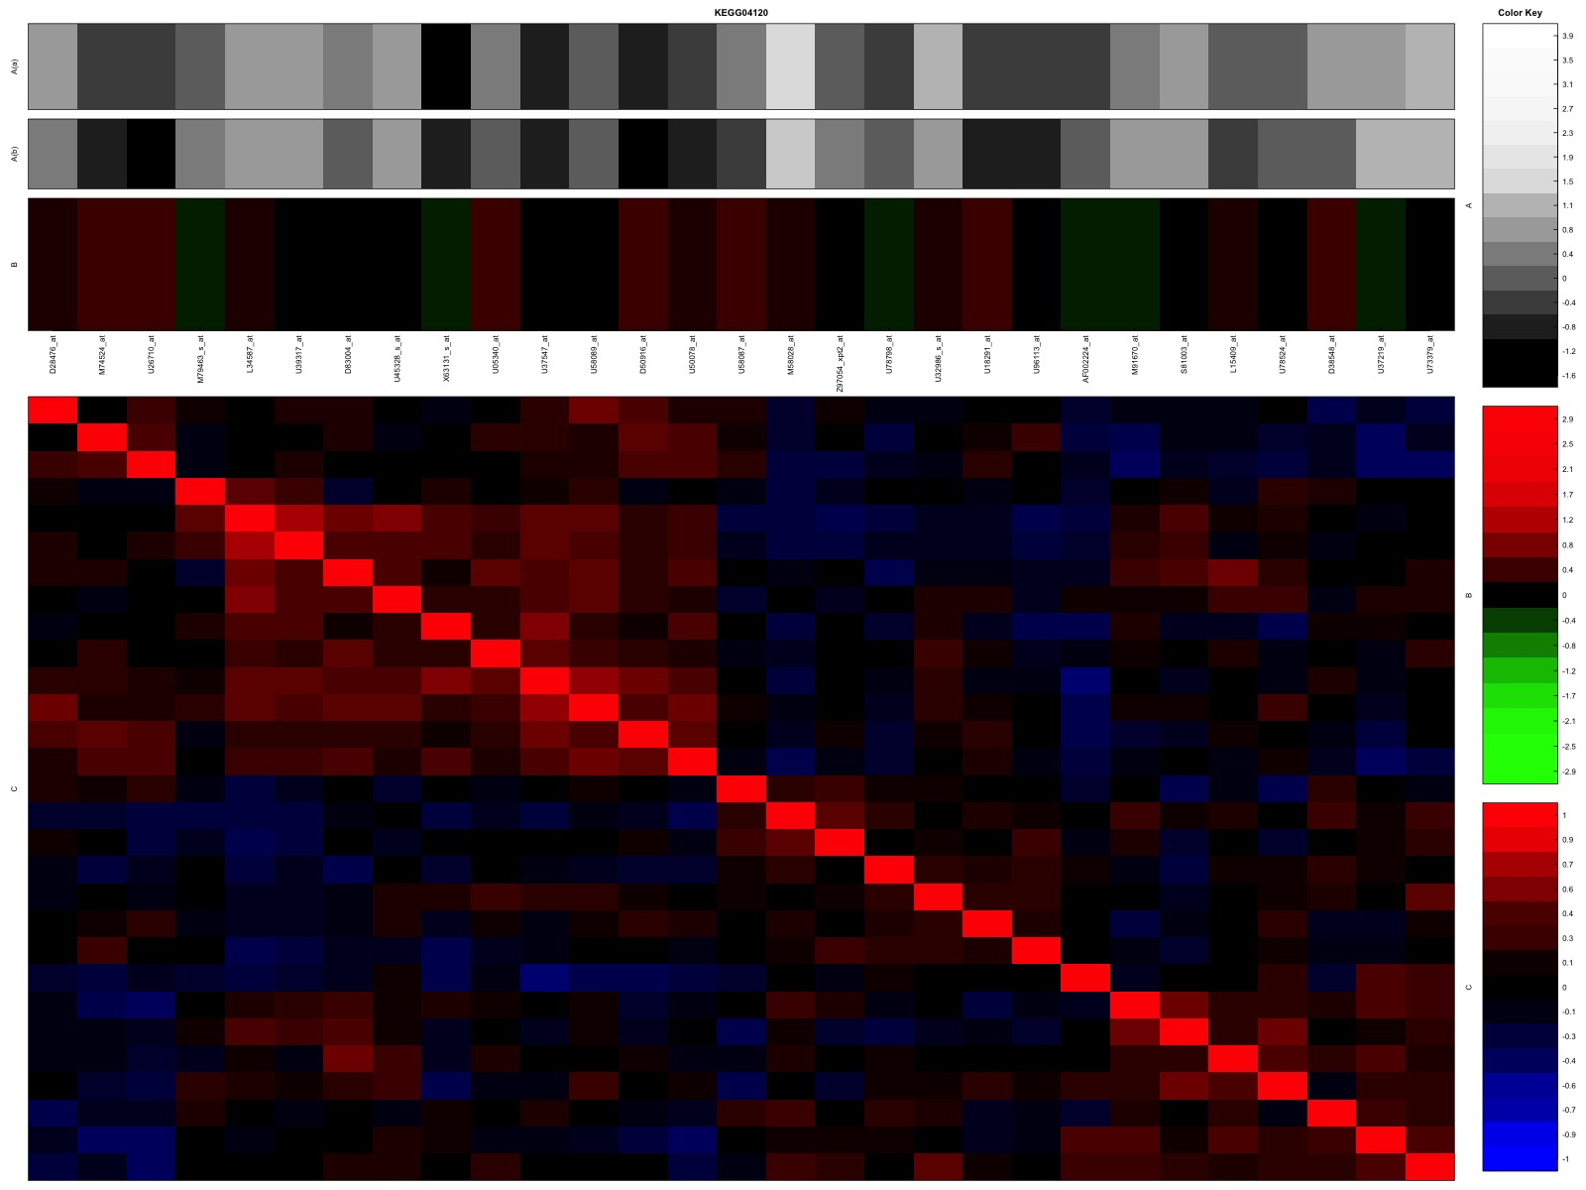
The corplot function
This function visualize both correlation and gene expression information for a particular gene category.
White-Black bar : expression of genes in 2 sample classes
Green-Black-Red bar : Differences of expression of genes between sample classes
Blue-Red plots : Correlation of genes

Slide 10
aveProbes function
In micro array data, a unique gene can often link to multiple probe sets, and such genes have a greater influence on the pathway analysis.
aveProbe function change the multiple probe data to the unique gene data.
Requires 3 arguments
1. gene expression data matrix
2. a matrix indicating presence or absence of genes in the gene sets
3. a vector of genes which match to the probe
Output : new gene expression data matrix

Slide 11
2. a matrix indicating presence or absence of genes in the gene sets
rows:genes columns:gene sets values:if the gene contained in the gene sets (0 or 1)

Slide 12
3. A vector of genes which match to the probe.
This is vector, not matrix
In some case, a unique gene link to multiple probes.

Slide 13
aveProbes function
In micro array data, a unique gene can often link to multiple probe sets, and such genes have a greater influence on the pathway analysis
Output : new gene expression data matrix

Slide 14
Babelomics
A web application for the functional analysis of gene expression and genomic data.
(http://www.babelomics.org/)

Slide 15
Log in (or create an account)
You can use as an anonymous user.
If you create an account and log in, you are given 10Gb of free disk space.

Slide 16
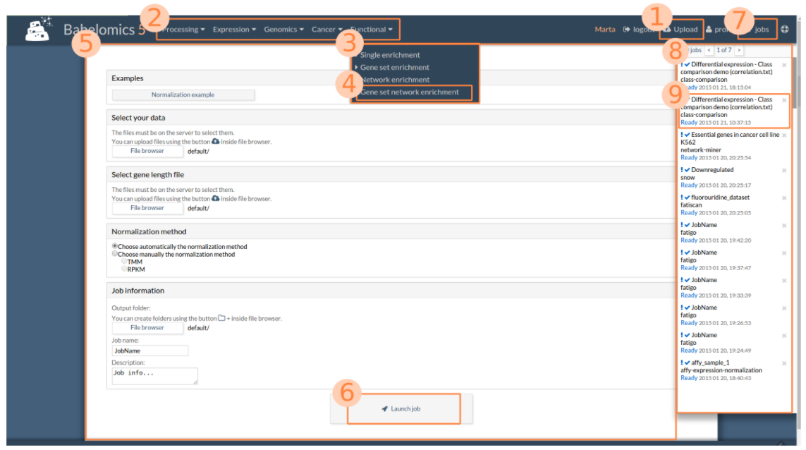
Work flow
1. You can upload the data from here.
2. main menu.
3. By clicking the category in the menu, a drop down box appears.
4. This box lists the tools.
5. To launch a tool, you need to fill in the required information of the input form.
6. Launch job button to start the job.
7. jobs button.
8. By clicking jobs button, job panel will appear showing all your jobs and their state.
9. If the job is ended, you can click the job to get the result.

Slide 17
The main menu
Consists of 5 categories.

Slide 18
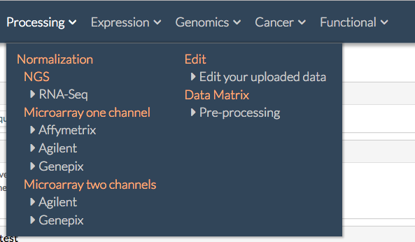
1. Processing
You can edit your data before analysis here.
Includes RNA-Seq normalization, expression microarray normalization, the edition of the data sets and data matrix pre-processing.

Slide 19
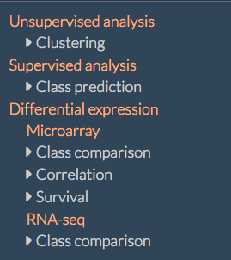
2. Expression
Includes belows.
1. Clustering of genes or samples
2. Class prediction of the samples
3. Differential expression analysis of microarray or RNA-seq data

Slide 20
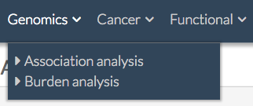
3. Genomics
Include 2 tools for genomic data analysis.
Association analysis tool allows the study of SNPs applying microarray technology.
Burden test can detect rare variants in sequencing data.

Slide 21
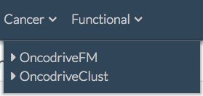
4. Cancer
Includes 2 approaches to analyze cancer genomic sequences.
OncodriveFM is a method to identify cancer drivers from cancer somatic mutations in a cohort of tumors.
OncodriveClust is a method to identify genes in which mutations accumulate within specific regions of the protein, which can be related to tumour.

Slide 22
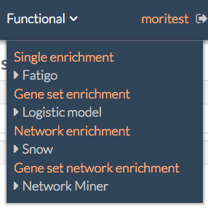
5. Functional
Includes tools for the functional analysis of the genomic data.
Single enrichment … Compare two group of genes and detects significant over-representation of genes.
Gene set enrichment … Almost same as Single enrichment. This tool is not for a single gene but for gene sets.
Network enrichment … Test if a group of genes or proteins represent any biological process.
Gene set network enrichment … Detects gene sets that are consistently associated to high or low values in specific genes.

