Slide 1
Omics seminar - 03
Prasadi De Silva

Slide 2
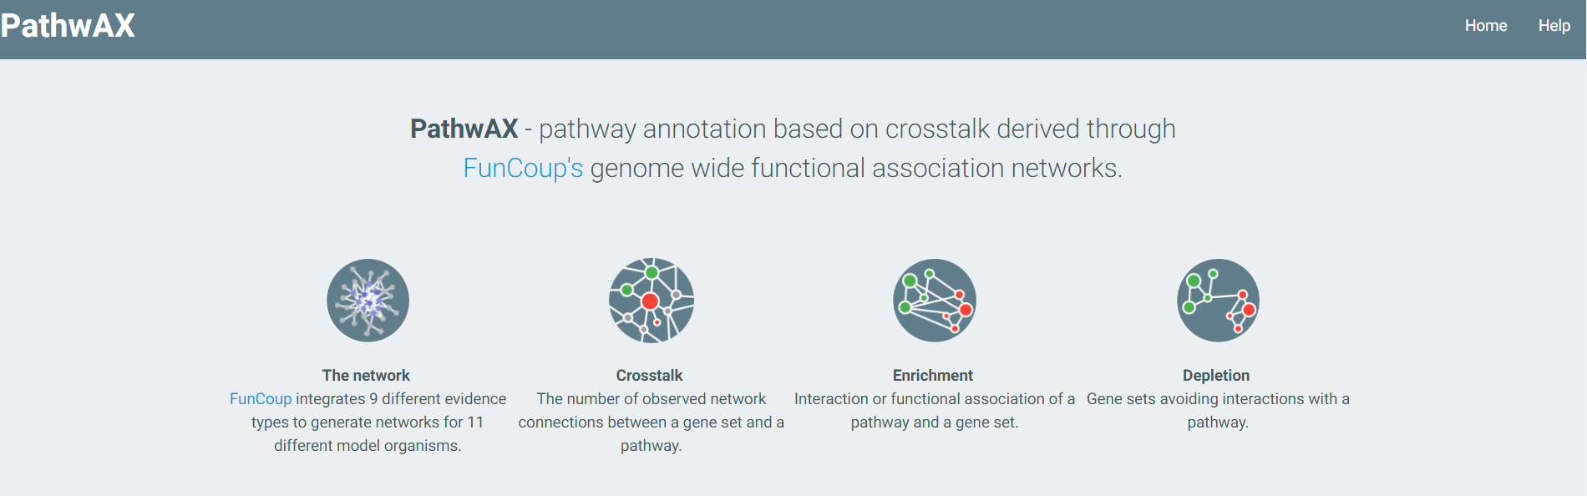
http://pathwax.sbc.su.se/

Slide 3
Introduction
A webservice for pathway annotation based on crosstalk derived through FunCoup, a framework for genome wide functional association networks.
PathwAX runs the BinoX algorithm, which employs Monte-Carlo sampling of randomized networks and estimates a binomial distribution, for estimating the statistical significance of the crosstalk.
A pathway is statistically enriched/depleted if the crosstalk, which is the number of links between the pathway and your gene set, is more/less than one would observe in a random network.
This results in substantially higher accuracy than gene overlap methods.

Slide 4
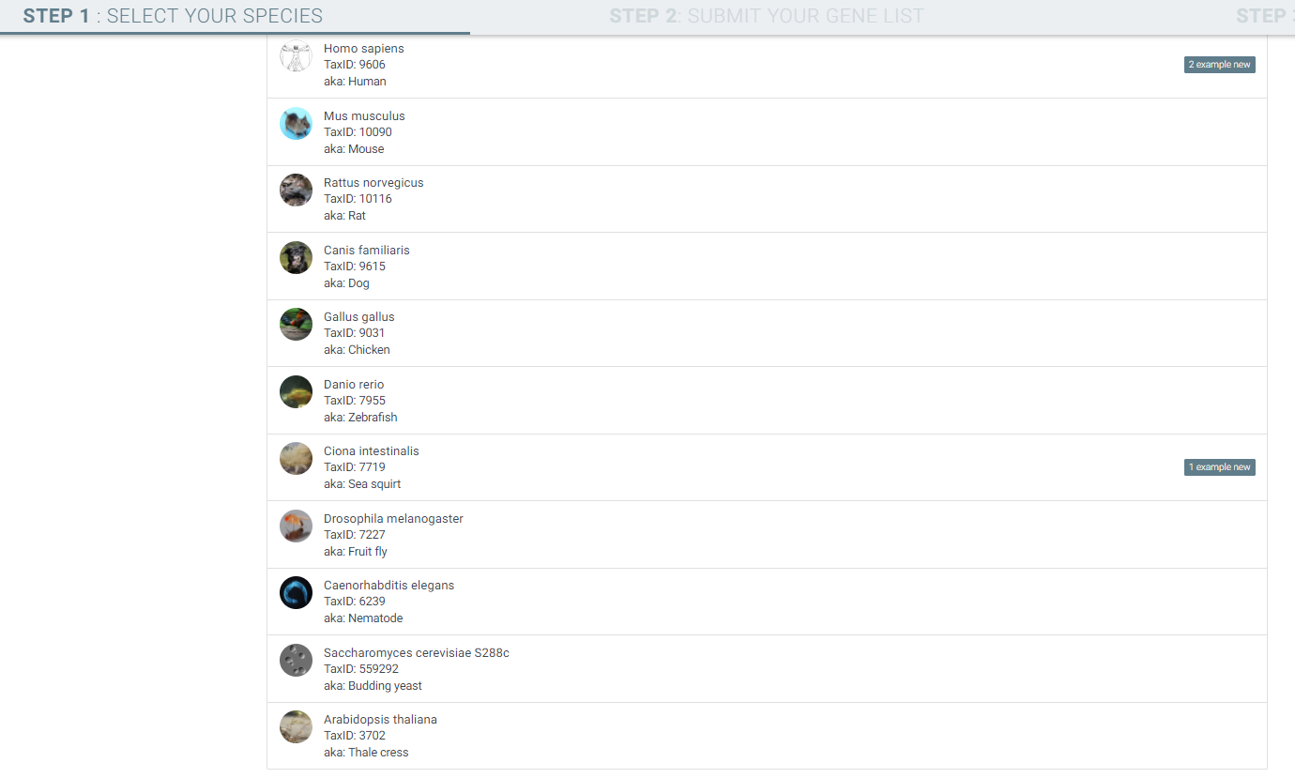
1. Select species

Slide 5
2. Submit the gene list

Slide 6
Example
Step 01:
Step 02:
Insert gene list

