Slide 1
Over-Representation Analysis (ORA)
Gene Set Enrichment Analysis (GSEA)
Network Topology-based Analysis (NTA)

Slide 2
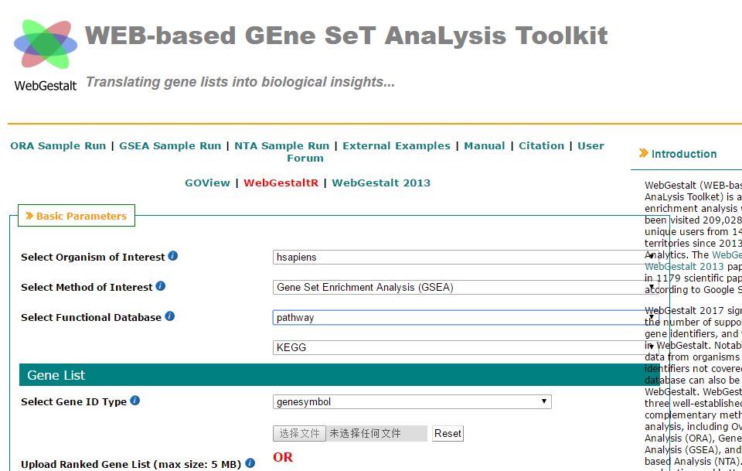
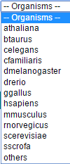
Show example analysis
Species selection
Analysis method selection
Gene ID type

Slide 3
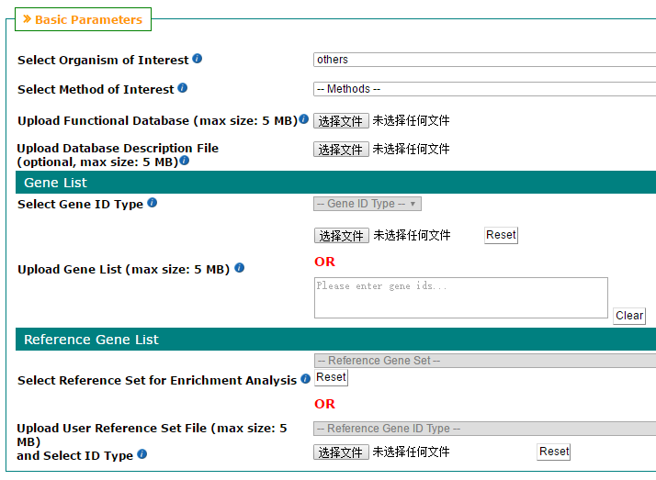

Slide 5
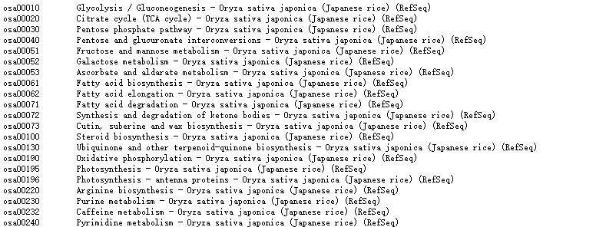

Slide 6
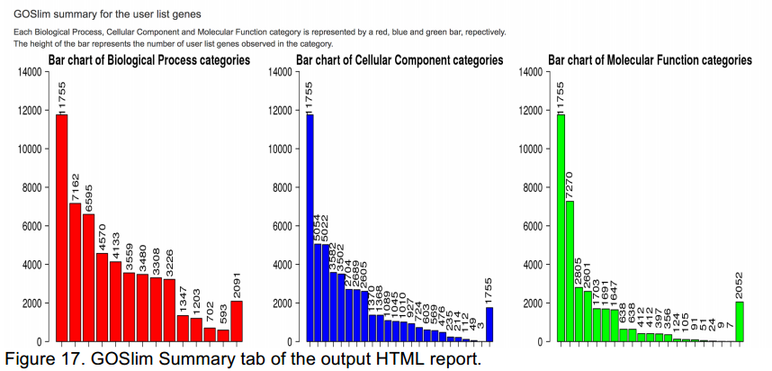
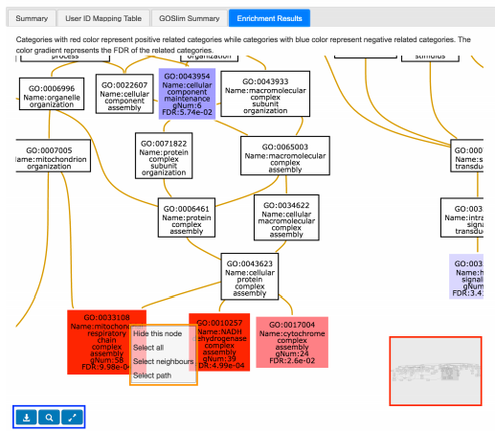
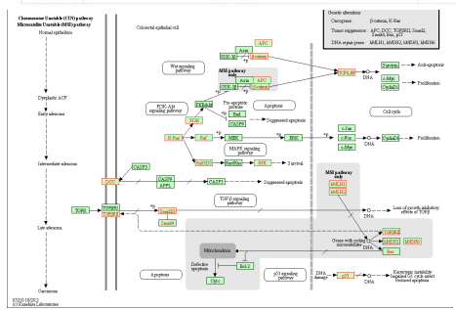

Slide 7
R packages: DESeq2
Estimate variance-mean dependence in count data from high-throughput sequencing assays and test for differential expression based on a model using the negative binomial distribution.

Slide 8
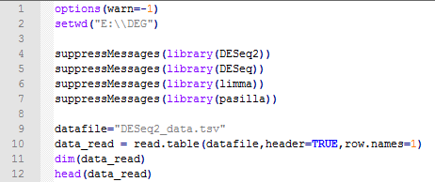

Slide 9
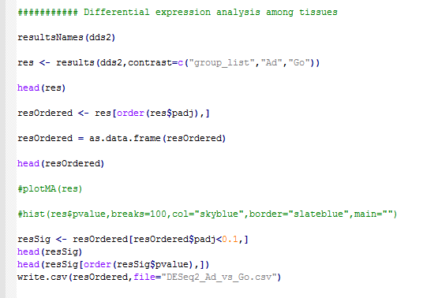

Slide 11
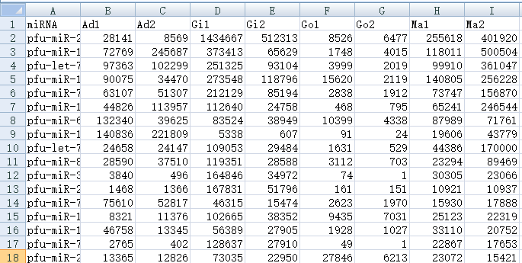
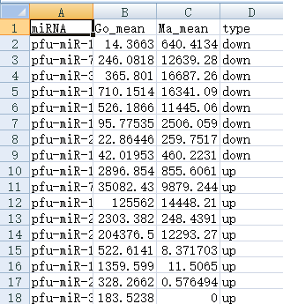
DESeq2_data.tsv
DEG_Go_vs_Ma.csv

