Slide 1
R packages RCAS RNA Centric Annotation System
Songqian Huang
2018-01-12

Slide 2
Usage:
Perform annotation summarization,
GO term and gene set enrichment analysis,
de novo sequence motif discovery.
Imperfection
Only deal with human, mouse, worm and fly gene annotation.
(human hg19, mouse mm9, worm ce10 and fly dm3.)

Slide 3
Install SCAR packages:
source(“http://bioconductor.org/biocLite.R”)
biocLite(“SCAR”)

Slide 4
UTR:http://rcas.mdc-berlin.de/
Input bed file

Slide 5
How to prepare a bed file for a RNA-seq data?
Step1: Choosing the special genome data as reference, and download from USCS or ensembl;
Step2: Make a index file for the special genome;
bowtie2-build hg19.fasta hg19
Step3: Mapping the RNA-seq data to the genomic data to get a sam file;
tophat –p 8 –G /path/hg19.gtf -o tophat_output /path/hg19 RNA- seq_1.fastq RNA_seq_2.fastq
Step: Changing the mapped sam file to bed file for RCAS;
samtools view </path/samfilename.sam> -Sb | bamtoBed –i stdin > Bedfilename.bed

Slide 6
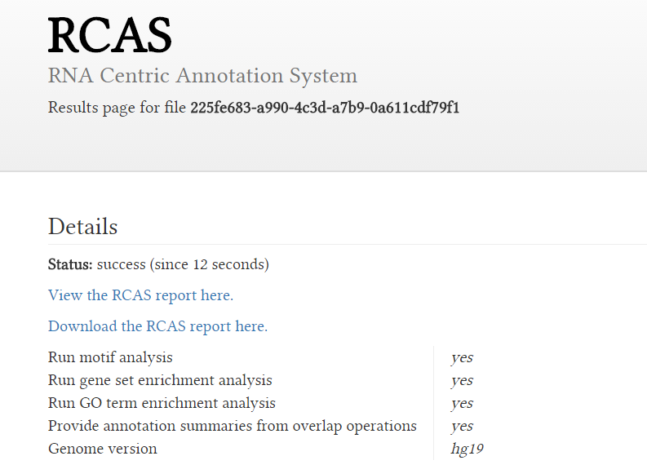

Slide 7
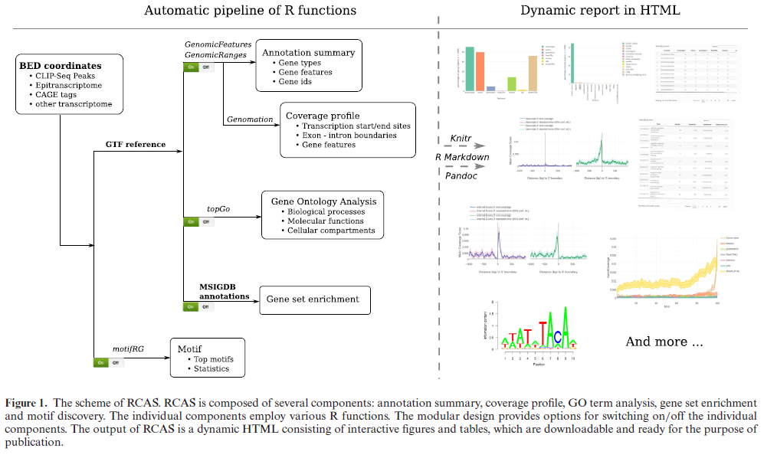

Slide 8
Thank you !

