Slide 1
Over-Representation Analysis (ORA)
Gene Set Enrichment Analysis (GSEA)
Network Topology-based Analysis (NTA)

Slide 2
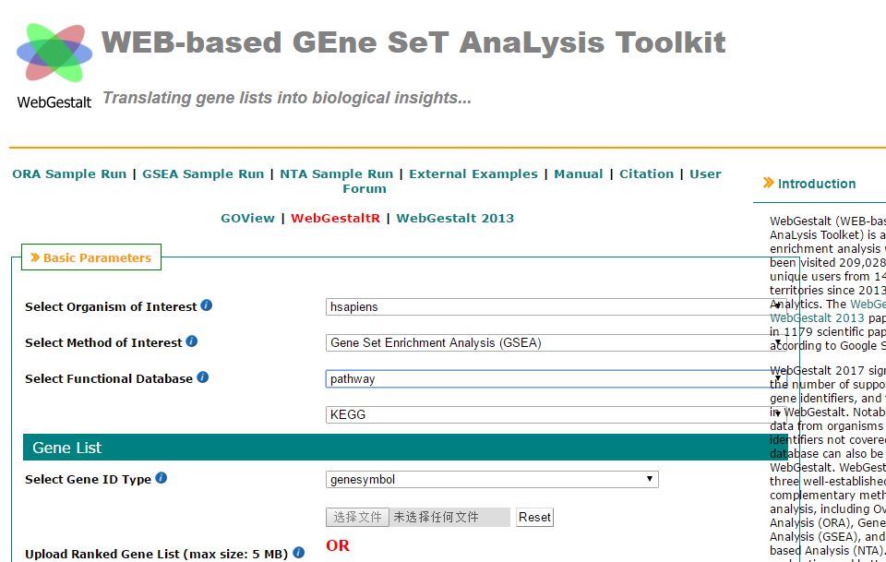
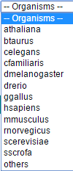
Show example analysis
Species selection
Analysis method selection
Gene ID type

Slide 3
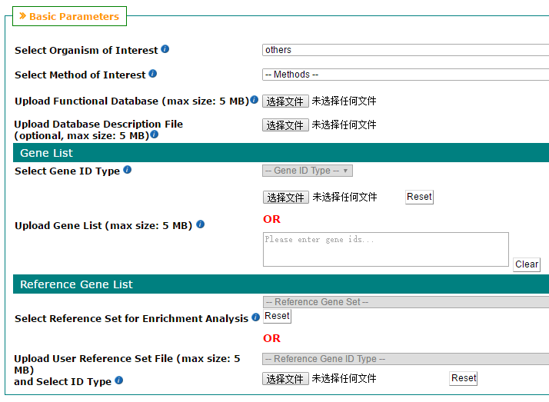

Slide 5
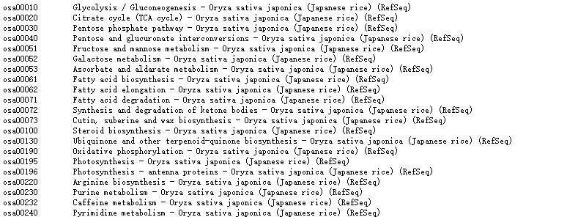

Slide 6
