Slide 1
IMP
By Waraporn Kraitavin, D2

Slide 2
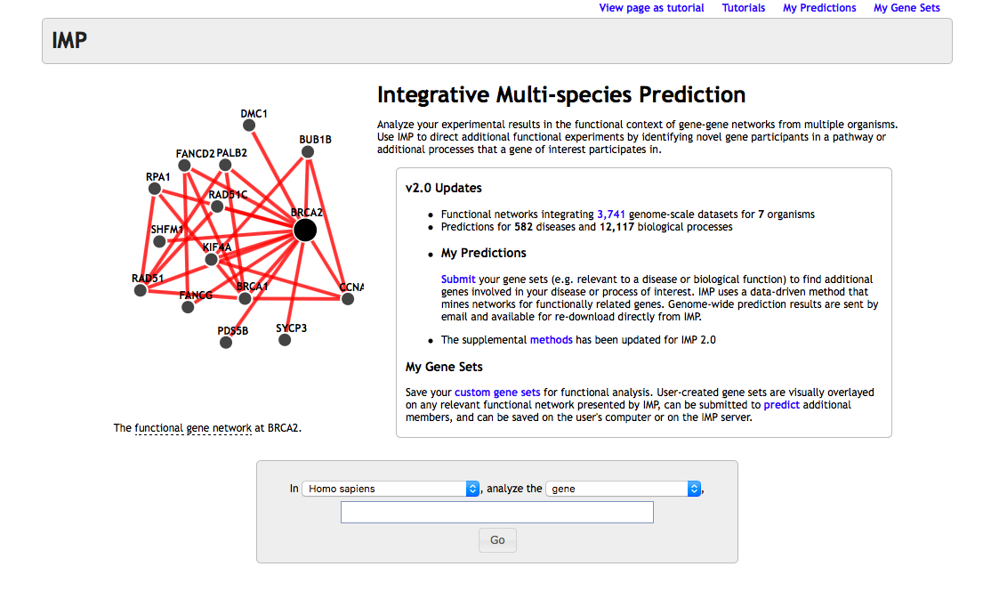
What is about the IMP?

Slide 3
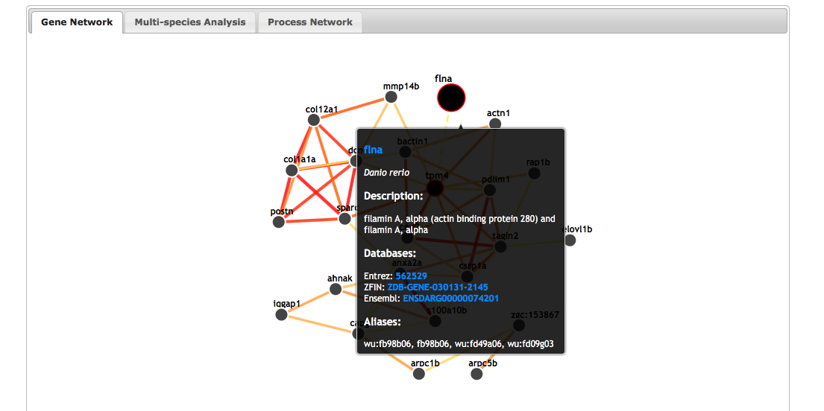
How does it works? (gene set)
1.
4.
2.
3.

Slide 4
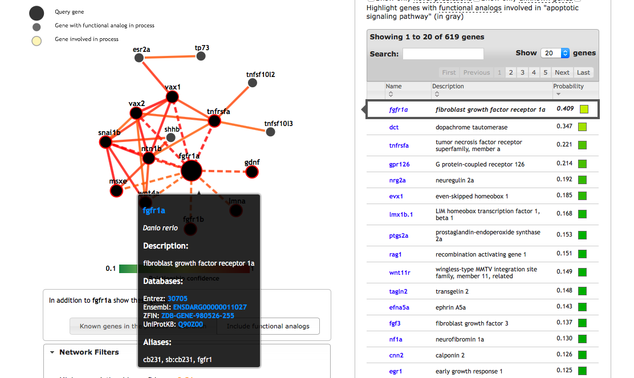
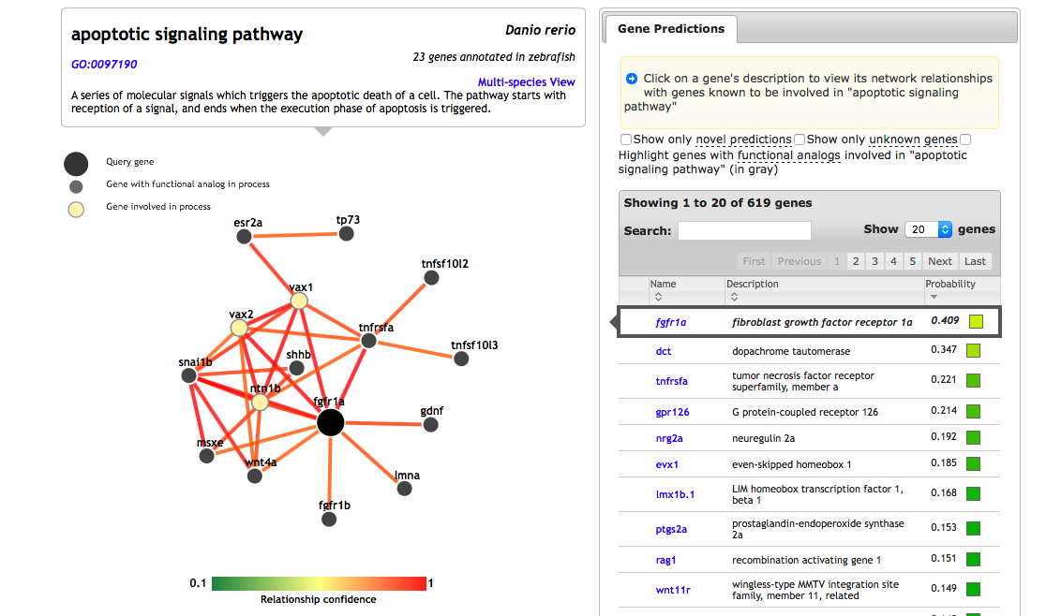
How does it works? (biological processes)
1.
3.
2.

Slide 5
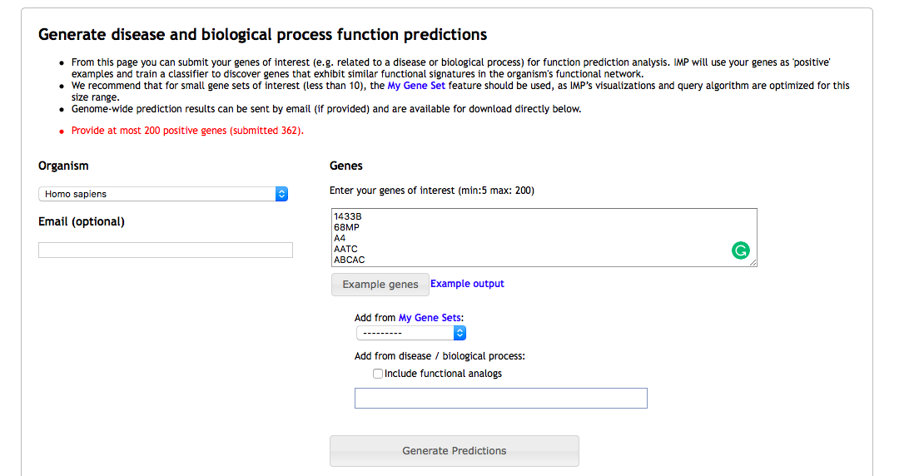
How does it works? (if you have more than 200 genes)
1.
2.

Slide 6
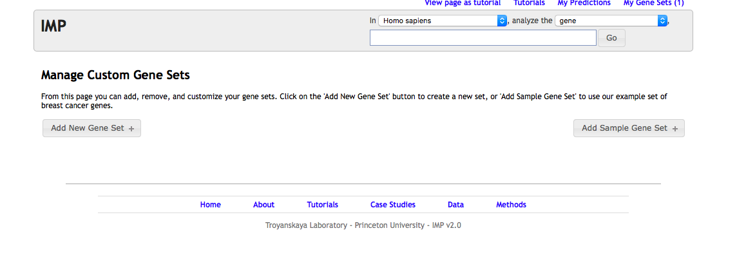
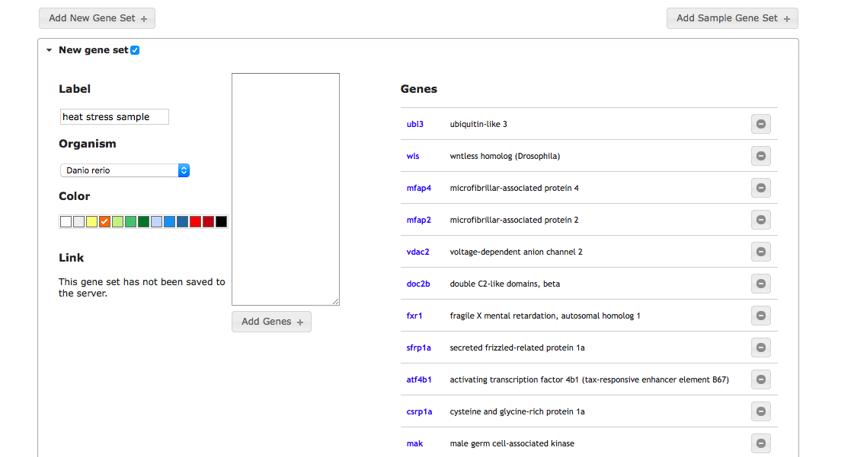
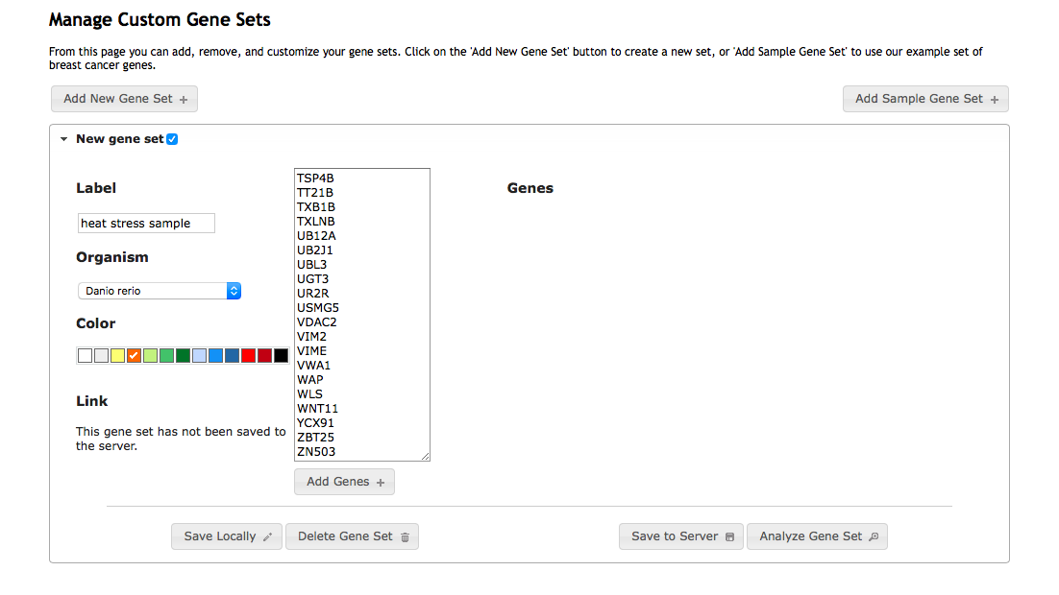
How does it works? (if you have more than 200 genes)
1.
3.
2.
4.

Slide 7
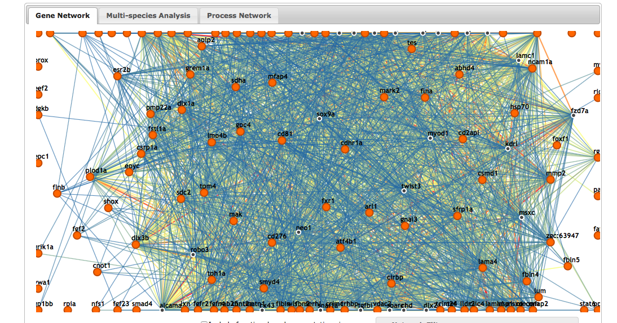
How does it works? (if you have more than 200 genes)

Slide 8
Thank you

