Slide 1
The expression profiles of miRNA-mRNA
of early response in genetically improved
farmed tilapia (Oreochromis niloticus) liver
by acute heat stress
Jun Qiang, Wen J. Bao, Fan Y. Tao, Jie He, Xia H. Li, Pao Xu and Lan Y. Sun
By KRAITAVIN Waraporn, D2 (2017/12/19)
Notes:
Good morning everyone, today I’d like to present about The expression profiles of miRNA-mRNA of early response in genetically improved farmed tilapia (Oreochromis niloticus) liver
by acute heat stress. That kind of fish is very famous in Southeast Asia, also in Thailand.

Slide 2
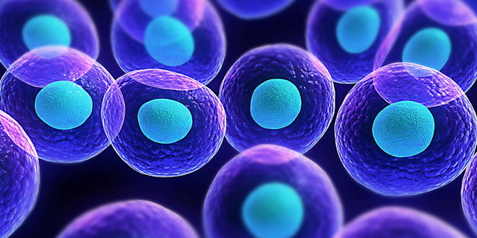

Stress responses in fish
Environmental stresses
(water temperature)
immune defense
digestive enzyme activity
protein synthesis
growth processes
Reproductive
Eulalia et al. (2011)
There are two mains that used to sense a sudden temperature change;
  induced accumulation of denatured proteins
  stimulated thermosensory structure, DNA, RNA, proteins, and lipids which direct effect or lead to the activation of signal transduction pathways
In the cell
Notes:
First of all, let’s me introduce briefly about heat stress in fish.
When the water temperature exceeds, it has effect with immune defense, digestive enzyme activity, protein synthesis as well as growth processes are repressed.
In the cell, there are two mains effect, induced accumulation of unfolding protein, stimulated HSP, and stimulated thermosensory structure such as DNA, RNA, proteins, and lipids which lead to the activation of signal transduction pathways.

Slide 3
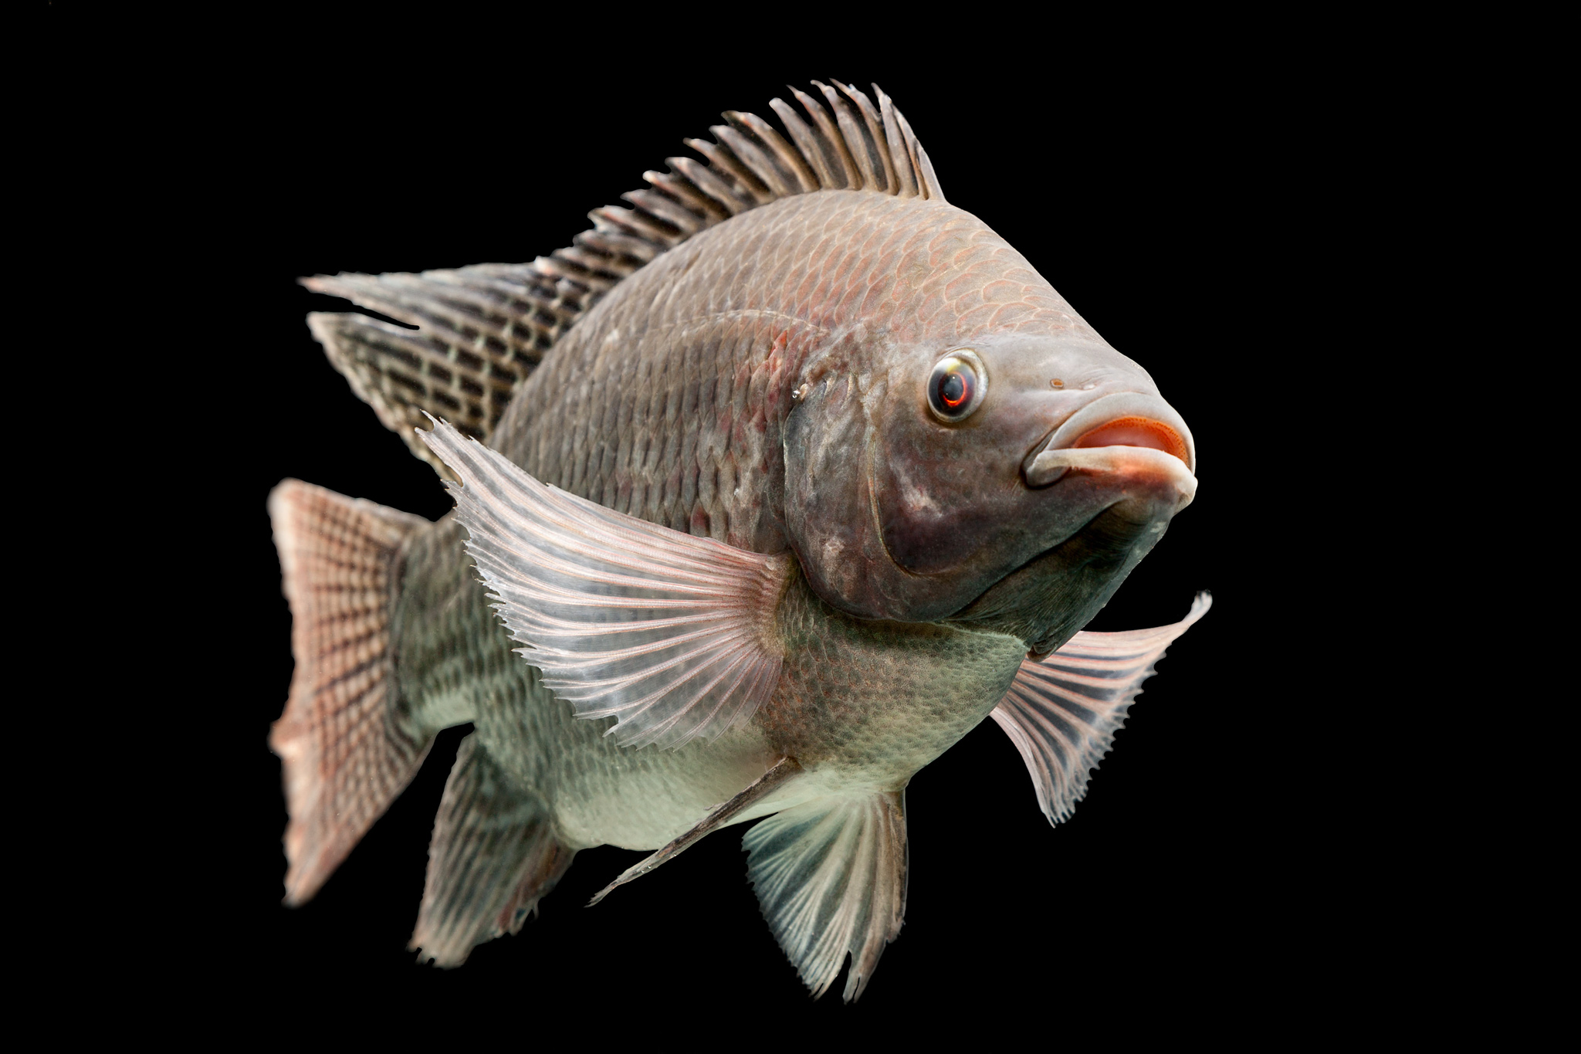
GIFT (tilapia, Oreochromis niloticus)
Tilapia is a freshwater fish, they has been introduced over 135 countries. Especially, China is the world’s largest producer of tilapia.
Tilapia is an important source of affordable, high yields protein. The normal temperature range growth is 20-33 ºC
GIFT is a genetically improved farmed tilapia, they have been established since 1988, they were developed to be fast growing and adaptable to wide range of environmental.
Notes:
Tilapia is a popular fish, they have been introduced several countries because they is an inexpensive and high protein.
The GIFT is a genetically improved farmed tilapia, they were developed to be faster growing and adaptable.

Slide 4
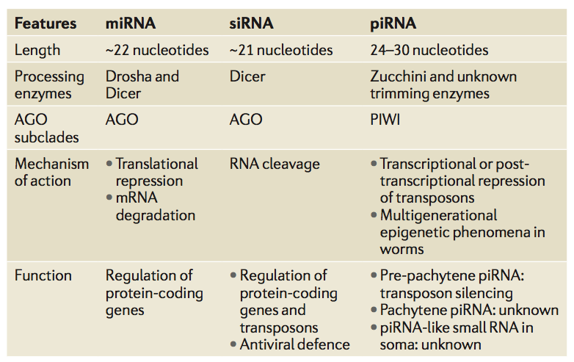
miRNAs
Classification of small silencing RNAs in animals
microRNAs (miRNA) are a class of small
non-coding RNAs (18-25 nucleotides) produced by two RNase III proteins-Drosha and Dicer.
The function miRNA is RNA silencing and post-transcriptional regulationnn of gene expression by binding to 3’-untranslated regions of target mRNAs.
Minju and V. Narry (2014)
Notes:
miRNAs are a class of small non-coding RNAs, the function of miRNAs are translational interference and transcript degradation. miRNAs has a negative interaction with mRNA. The translation is repressed.

Slide 5
The aim of this study
Due to in recent year, the summer temperature in southern China have been above 36ºC, and they have found GIFT are highly susceptible to diseases in summer.
Determining relationship between heat stress signaling pathways and adaption mechanisms of the GIFT under heat stress.
Contribute to breeding new high-temperature tolerant strains of GIFT

Slide 6
Assessment of 48-h LT50 in GIFT under heat stress
35.5ºC
36ºC
36.5ºC
37ºC
37.5ºC
38ºC
38.5ºC
39ºC
Notes:
The GIFT used in this study were 16th generation in same genetic background and were offspring of the same family. A total of 540 fish we selected for this experiment, and they were acclimatized in tanks containing 28ºC water.
They determined by observing the fish at eight groups temperature: 35.5, 36, 36.5, 37, 37.5, 38, 38.5, and 39ºC. Eight treatments with three replicates, each with ten fish,
The cumulative mortality of each treatment group within 48h was counted

Slide 7
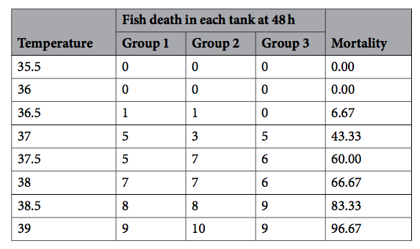
Table 1: Comparison of the mortality of GIFT at hight temperature stress for 48 hr (48-h LT50)
37.5 C was chosen as the heat stress
temperature acute
Notes:
An increase of water temperature (35.5 to 39 ºC) significantly increased the mortality of the GIFT after 48h under heat stress.
The 48-h LT50 was determined as 37.5ºC by linear interpolation.
So, they chose the 37.5ºC as the heat-stress temperature for this study.

Slide 8
Following the time periods post heat stress
CO-1
CO-2
CO-3
At temperature 28ºC, the control group (CO) livers were obtained and stored in liquid nitrogen
HTS-1
HTS-2
HTS-3
The temperature was rapidly increased to 37.5ºC using heaters.
Blood samples from three fish per tank were obtained following time periods post-heat stress: 0, 6, 12, 24, 36, and 48 h
Notes:
The 300 GIFT were stocked in tanks (50 fish per tank) at the initial temperature of 28ºC. They classified into six groups; three control groups (CO-1,CO-2, and CO-3) and three heat-stressed groups (HTS-1, HTS-2, and HTS-3).
The control GIFT groups were at the temperature 28ºC and livers were immediately removed and stored in liquid nitrogen.
For the HTS groups, they would like to know what time periods post heat stress (37.5ºC) that has the most effective to the fish then they decided to classify into six time periods post heat stress; 0, 6, 12, 24, 36, and 48 h measure by blood samples (WBC, RBC counts, and lysozyme activity).

Slide 9
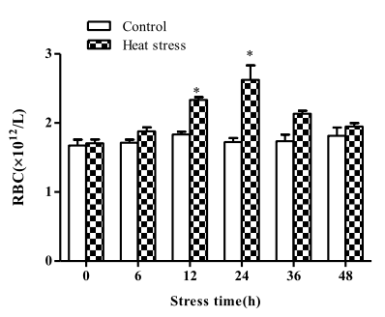
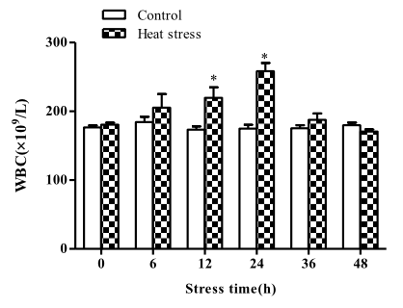
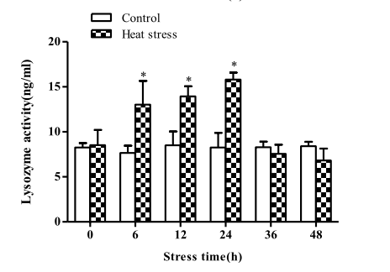
Figure 1: Red blood cell (RBC) and white blood cell (WBC) counts in blood samples, and serum lysozyme activity in GIFT between control (CO) and 37.5C heat-treated (HTS) groups for 48 h. (p<0.001)
Notes:
As the results shown the WBC, RBC counts, and lysozyme activity in HTS-GIFT increased from 0 to 24h and then decreased at 36 and 48h.

Slide 10
Treatment and sampling GIFT under heat stress
HTS-1
HTS-2
HTS-3
Then they chosen at 24h post 37.5ºC as the heat stress treatments (HTS) in this study.
Livers were immediately removed and stored in liquid nitrogen.
Notes:
Based on this results, they decided to use from 24h post 37.5ºC of HST-GIFT to investigate the regulatory mechanisms of miRNA-mRNA interactions.
The temperature of HST-GIFT groups were rapidly increased to 37.5ºC and livers were sampled at 24h of heat stress and stored in liquid nitrogen.

Slide 11
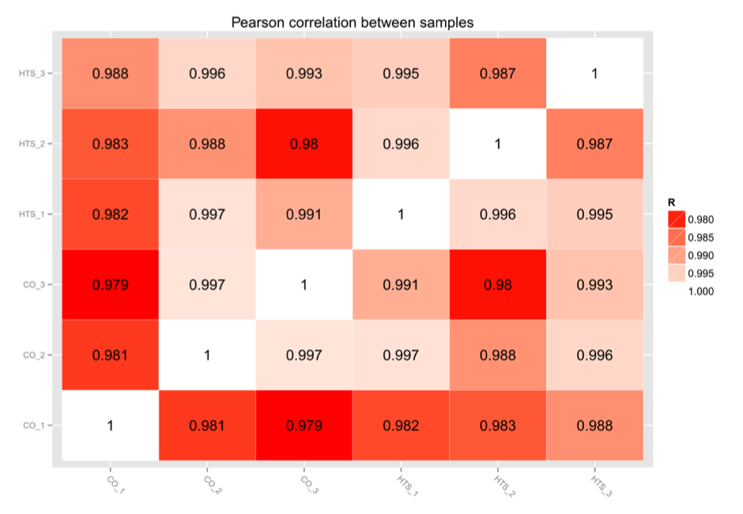
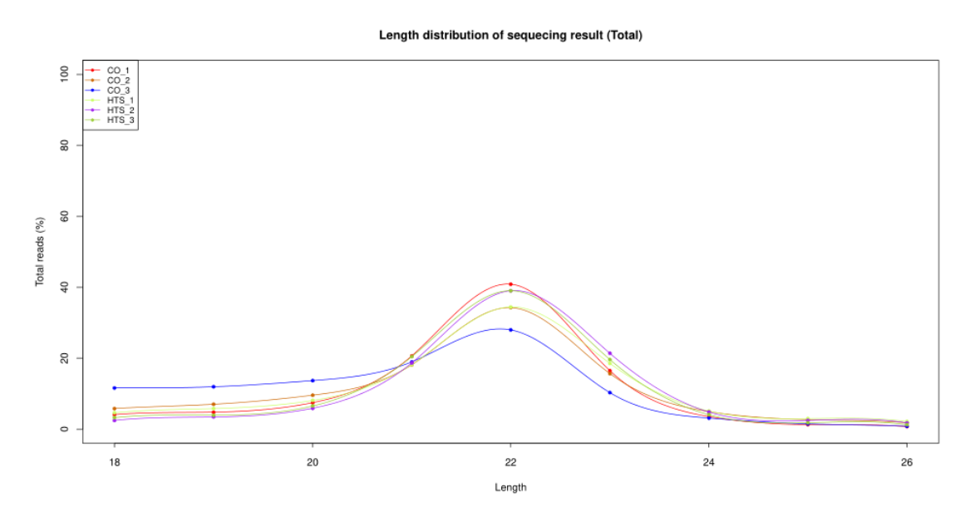
(a)
(b)
The most abundant long reads miRNA
Figure 2: (a) the repeatability analysis of miRNA libraries between samples, and (b) distribution of the assembled genes and transcript leanght.
Notes:
As the results, the biological replicates had good repeatability on the left side, and they found the 22-nt long reads were the most abundant in the six libraries.

Slide 12
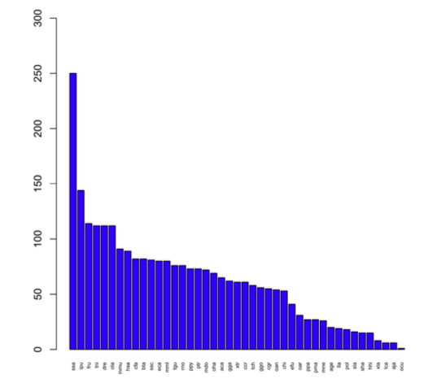
Figure 3: Conservation profiles of the identified GIFT liver miRNA with miRNA
from other fish species.
highly conserved miRNA with Salmo salar
Notes:
They detected 529 conserved miRNAs belonging to 96 miRNAs families. The large proportion of the miRNA precursors from other fish species listed in miRBase 21.0, including Salmo salar (ssa), Zebrafish (dre).

Slide 13
Table 2: Reads for miRNA-seq of GIFT from raw data to cleaned sequences
 | miRNAs
 | CO-1 | CO-2 | CO-3 | HTS-1 | HTS-2 | HTS-3
lib | Total | Total | Total | Total | Total | Total
Raw reads | 13,602,611 | 13,029,563 | 14,426,681 | 14,395,061 | 11,506,732 | 11,963,811
Valid reads | 7,336,868 | 6,080,277 | 5,233,861 | 7,645,402 | 6,614,342 | 6,033,205
They detected 46 predicted novel miRNAs
A total of 50 DE miRNAs were found between the CO and HTS libraries
28 DE miRNAs had P<0.05, fold-change ≥ 1.5 or ≤ 0.67, and reads per million reads (RPM) ≥ 5
  11 DE were significantly down-regulated
  17 DE were significantly up-regulated
Notes:
The expression profiling of miRNAs in heat stressed GIFT liver as shown in this table. They built and sequenced six miRNA libraries that I told you in the previous slides. A total of raw reads were obtained, you can see in this table. After removing reads that contained adaptor and low-quality reads in the valid reads (or clean reads) below.
Among clean reads, they detected 46 predicted novel miRNAs and 50 DE miRNAs were found between CO and HST groups. Among of 50 DE; 28 DE miRNAs had P<0.05, fold-change ≥ 1.5 or ≤ 0.67, and reads per million reads (RPM) ≥ 5, that contained 11 DE down-regulated and 17 DE up-regulated.

Slide 14
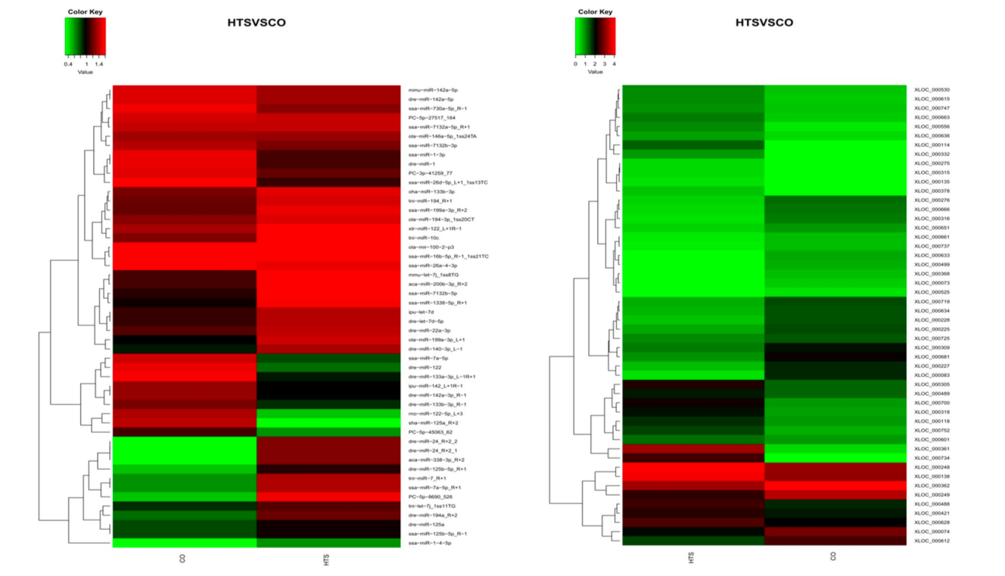
Figure 4: Hierarchical clustering of differentially expressed (DE) miRNA (a) and DEmRNAs (b) between control (CO) and 37.5C heat-treated (HTS) groups.
Notes:
The DE miRNAs divided into five biological processes as shown in heat map.

Slide 15
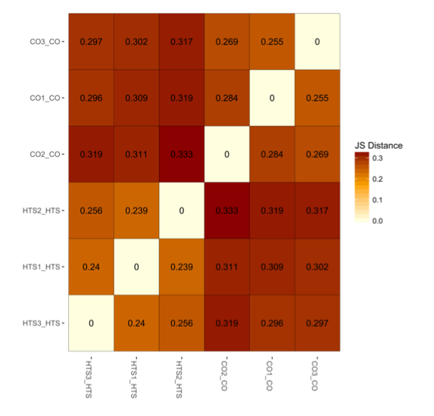
Figure 5: the repeatability analysis of mRNA libraries between samples
Notes:
the biological replicates had good repeatability

Slide 16
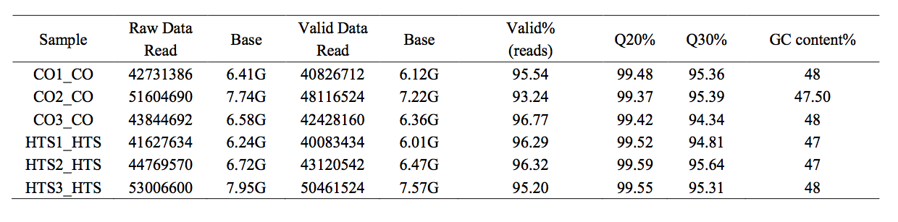
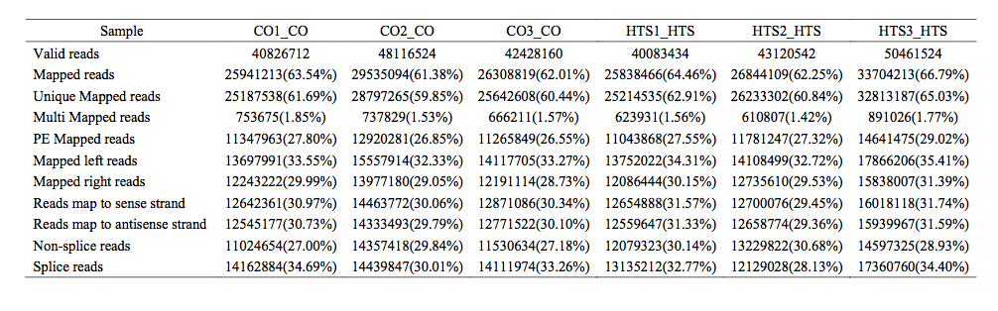
Table 3: Reads for mRNA-seq and sammary of read data aligned with Oreochromis_niloticus transcriptome of GIFT from raw data to cleaned sequences
Notes:
The expression profiling of mRNAs in heat stressed GIFT liver as shown in this table. Six libraries were built same with miRNAs the raw reads and clean reads were shown on the table. Among of clean reads were mapped to the Nile tilapia genome that shown on the table below.
They were found a total of 6685 DE mRNAs between CO and HST libraries. They identified 744 DE mRNAs that had P<0.05, fold-change ≥ 2.0 or ≤ 0.5, and reads per million reads (FPKM) ≥ 10.
Among of 744 DE mRNAs,
- 202 know genes were up-regulated
- 240 know genes were down-regulated in the HTS libraries compared with CO libraries.
- 62 were unknown genes
- 240 were novel genes

Slide 17
A total of 6685 DE mRNAs were detected between CO and HST libraries.
These DE were classified into five biological processes.
Figure 6: Hierarchical clustering of differentially expressed (DE) miRNA (a) and DEmRNAs (b) between control (CO) and 37.5C heat-treated (HTS) groups.
Notes:
A total of 6685 DE mRNAs between CO and HST libraries were classified into five biological processes, see on this picture.

Slide 18
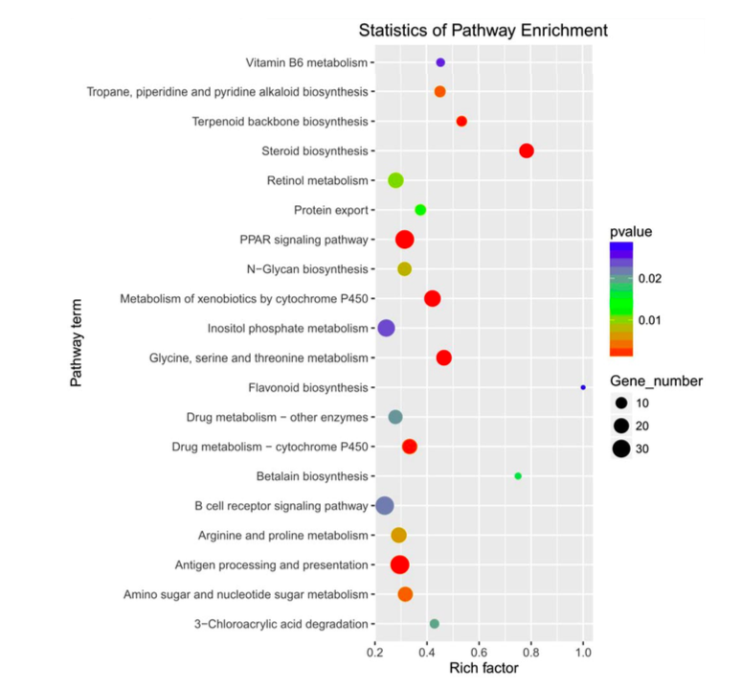
DE mRNA were identified 20 pathways by heat stress (P<0.05)
744 DE mRNAs were identified that had P<0.05, fold-change ≥ 2 or ≤ 0.5, and FPKM ≥ 10
  202 know genes were up-regulated
  240 genes were down-regulated
  62 were unknown genes
  240 were novel genes
Figure 7: KEGG pathway enrichment analysis of the DE mRNAs from the liver of GIFT exposed to 37.5ºC heat stress.
Notes:
A total of 6685 DE mRNAs were analysis to the KEGG pathways and identified 20 pathways that were enriched by heat stress (P<0.05)

Slide 19
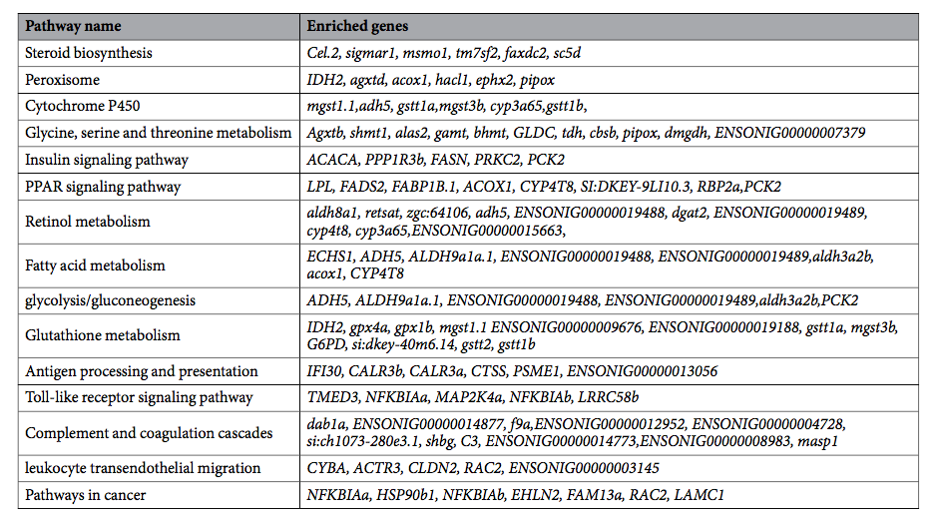
Table 4: Significantly enriched pathways involving differentially expressed genes in heat stressed GIFT liver.
Organism system
metabolism
immune regulation
* with ≥ 5 DE mRNAs
Notes:
The significantly enriched pathways (with ≥ 5 DE mRNAs) including;
- Organism system; steroid biosynthesis, cytochrome 450
- Metabolism; glycine, serine, and threonine metabolism, insulin signaling pathway, PPAR signaling pathway, retinol metabolism, fatty acid metabolism, glycolysis/gluconeogenesis, glutathione metabolism
- Immune regulation; antigen processing and presentation, Toll-like receptor signaling pathways, complement and coagulation cascades, leukocyte transendothelial migration, and pathways in cancer

Slide 20
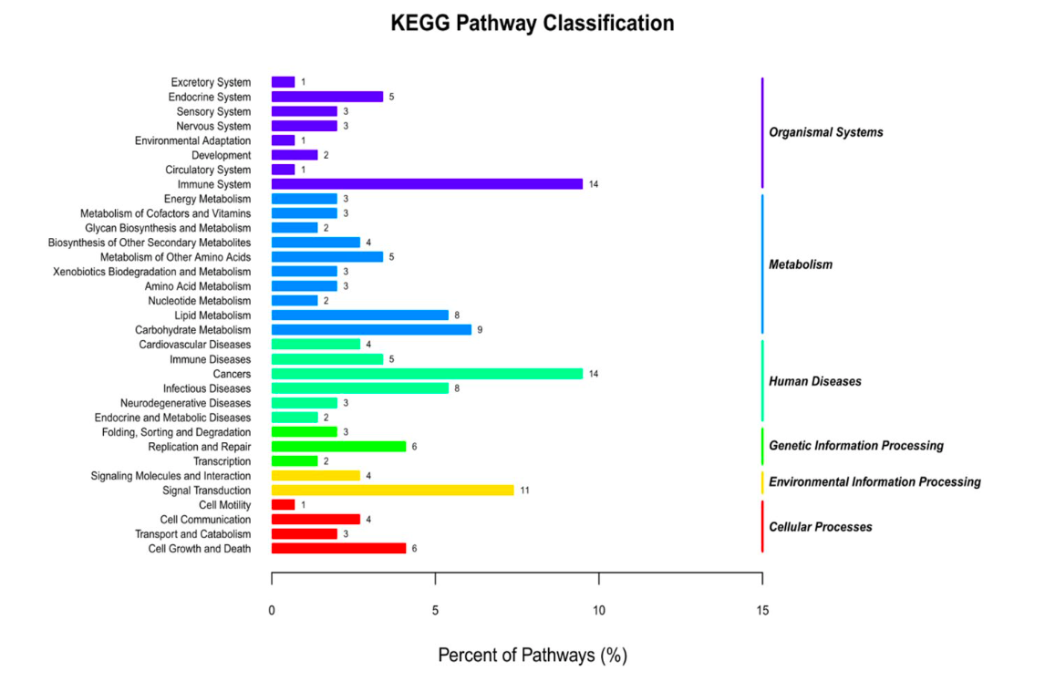
1525 of the miRNA-mRNA pairs (involving 50 DE miRNAs and 874 DE mRNAs) had negative correlation of their expression patterns.
These pairs were associated with 33 pathways.
Figure 8: Classification of the enriched KEGG pathways for the negatively correlated miRNA-mRNA pairs of GIFT exposed to heat stress.
Notes:
Integrated analysis of miRNA-mRNA expression, a total of 2295 target genes were predicted for the 50 DE miRNAs using TargetScan and miRanda. Both positive and negative were identified, they found 1525 of the miRNA-mRNA pairs, that involving 50 DE miRNAs and 874 DE mRNAs) had a negative correlation of their expression. These pairs were associated with 33 KEGG pathways.
Among these pathways divided into three subclasses such as organism, metabolism, and disease that included;
Sensory system
endocrine system
lipid metabolism
carbohydrate metabolism
immune system
cancers
infectious diseases

Slide 21
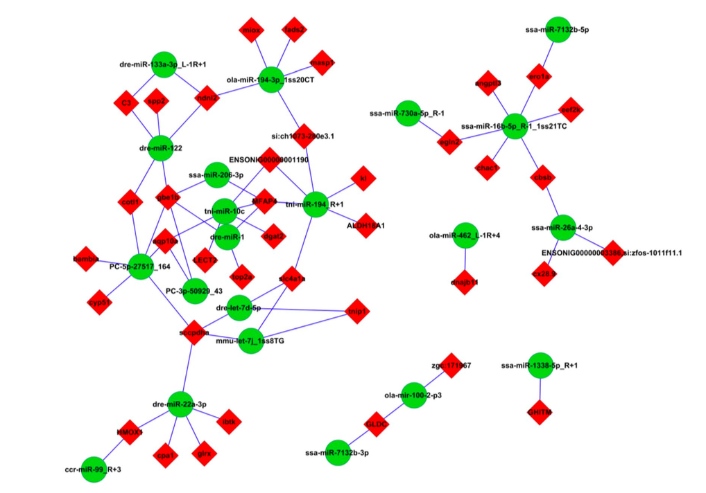
64 negatively correlated miRNAs-mRNAs interaction were selected which included;
  38 DE target mRNAs for 21 DE miRNAs
Following
  DE miRNAs, P<0.05, fold-change ≥ 1.5 or ≤ 0.67, and RPM ≥ 5
  DE mRNAs, P<0.05, fold-change ≥ 2 or ≤ 0.5, and FPKM ≥ 10
Figure 9: Analysis of the miRNA-mRNA negative correlation network.
Notes:
They selected 64 negatively correlated miRNA-mRNA interactions for screening based on the following;
DE miRNAs, P<0.05, fold-change ≥ 1.5 or ≤ 0.67, and RPM ≥ 5
DE mRNAs, P<0.05, fold-change ≥ 2 or ≤ 0.5, and FPKM ≥ 10

Slide 22
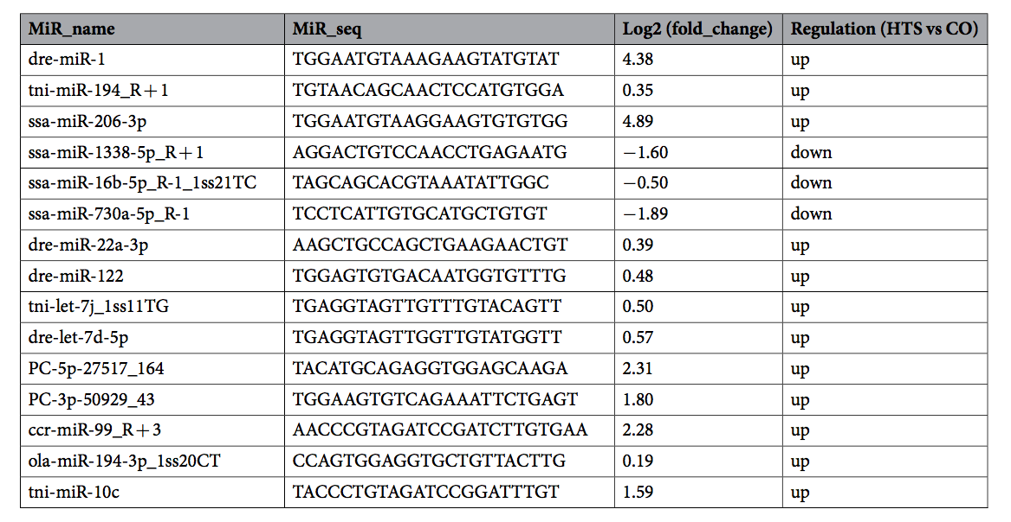
Table 5: The 15 differentially expressed miRNAs in heat stressed GIFT liver verified by qRT-PCR.
novel miRNAs
*Fold change = HTS group (mean)/CO group (mean), where “mean” is the mean of three biological replicates.
Notes:
They selected 15 DE miRNAs (13 known and two novel miRNAs).

Slide 23
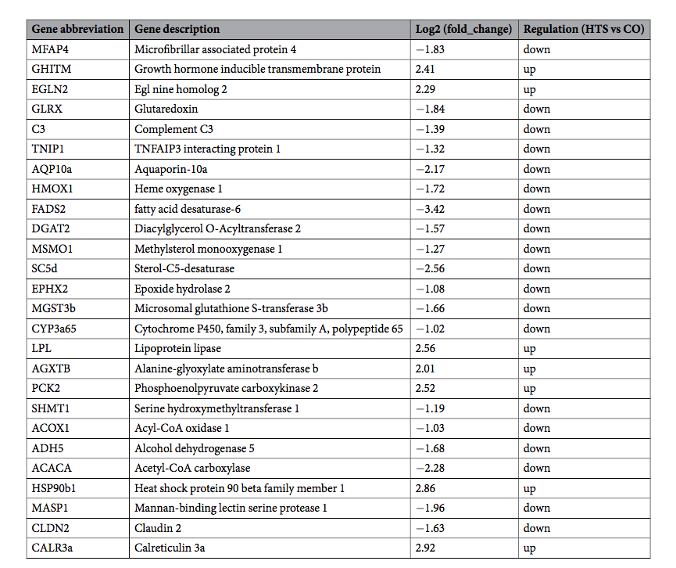
Table 6: The 26 DE mRNAs in heat stressed
GIFT liver verified by qRT-PCR.
16 other DE mRNAs
*Fold change = HTS group (mean)/CO group (mean), where “mean” is the mean of three biological replicates.
Notes:
Then they selected nine mRNAs from the screened miRNA-mRNA pairs, and 16 other DE mRNAs detected in the livers of heat stressed GIFT. They found only ACOX1 have no expression patterns

Slide 24
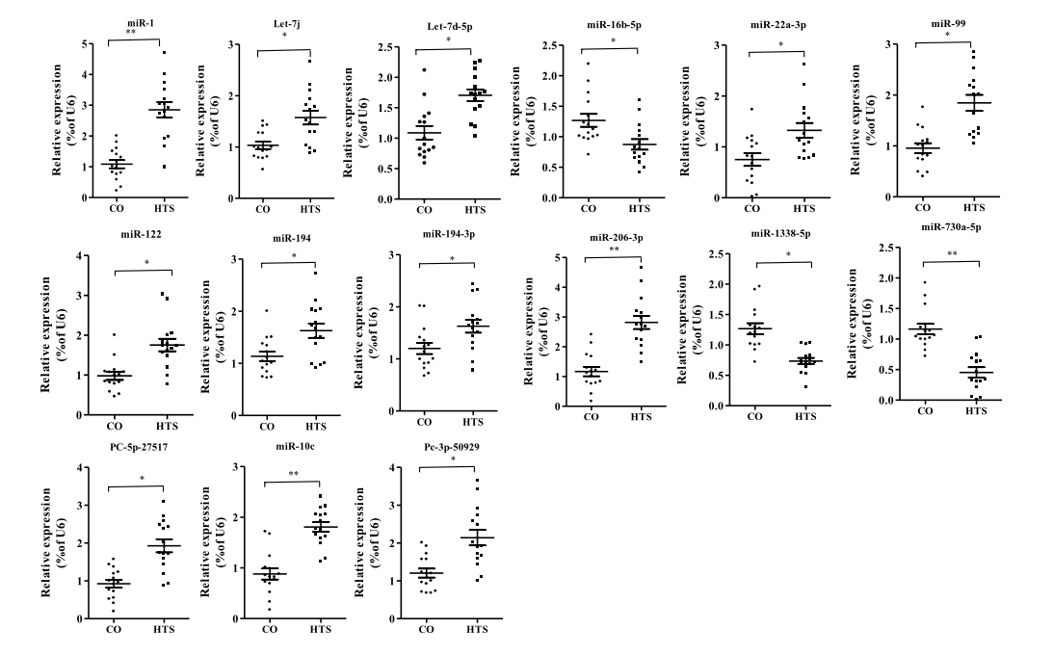
Figure 10: Validation of 15 DE miRNAs between control (CO) and 37.5 ºC heat stressed (HTS) by qRT-PCR.
*P<0.05 and **P<0.01 by unpaired Student’s T-tests
Notes:
They found all the selected miRNAs and mRNAs have been expression patterns.

Slide 25
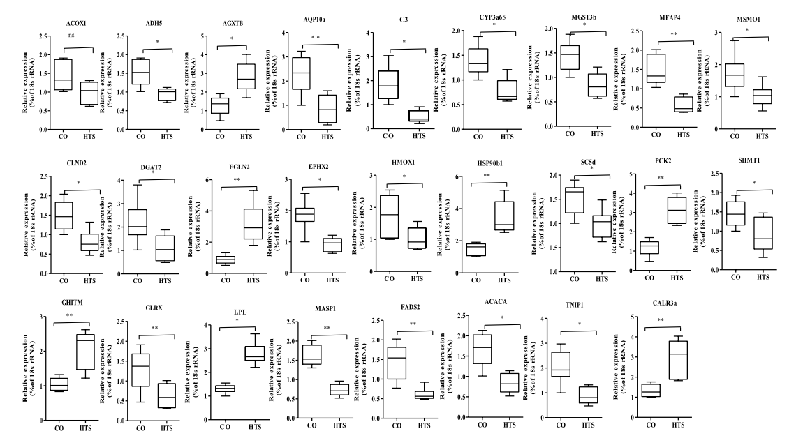
Figure 11: Validation of 26 DE mRNAs between control (CO) and 37.5 ºC heat stressed (HTS) by qRT-PCR.
*P<0.05 and **P<0.01, NS, no significant difference by unpaired Student’s T-tests
Notes:
They found only ACOX1 have no expression patterns

Slide 26
Discussions
They studied the early response in the liver of GFIT exposed to heat stress by deep sequencing CO and HTS libraries.
A total of 63.34%, 61.38%, 62.01%, 64.46%, 62.25%, and 66.7% of the valid reads in the CO-1, CO-2, CO-3, HTS-1, HTS-2, and HTS-3 libraries, respectively, mapped to the reference Nile tilapia genome.
In the KEGG pathway analysis, organism system, metabolism, and immune regulation were highly enriched among the DE mRNAs.

Slide 27
Discussions
Pathway | Gene abbreviation | Gene function | Heat stress responses
Organism system | SC5d | Encode enzyme involved cholesterol biosynthesis | May reduce the synthesis steroid hormones from cholesterol
 | MSMO1
 | EPHX2 | Increasing susceptibility to ischemic stroke in patient and may be associated with familial hypercholesterolamia
 | CYP3a65 | This is ortholog of CYP3a, involved in the biotransformation of most drug and enzyme factors | Detoxification of xenobiotic substances may have been impaired
 | MGST3b | Important role in the biotransformation of xenobiotics
Metabolism | PCK2 | Enhanced under low-glucose conditions, and increased usage of hepatic glycogen occurred under stress. | Up-regulated of PCK2, LPL, and AGXTB and down-regulated of SHMT1 and ADH5 were detected in this study may have stimulated an increase of glucose and lipid metabolism and expressed fatty acid 𝜷-oxidation which help to maintain homeostasis in liver under heat stress
 | LPL | Expression contributed to the conversion of TG to fatty acid in the liver to supply energy demand
Immune regulation | HSP90b1 | Play an important roles in tomor cell growth and promotors protein refloding | Overecpression of this gene was implicated in poor survival of patients
 | MASP1 | Don’t directly involved in complement activation | Play a role as a amplifier of complement activation
 | CLDN2 | A leak protein that forms a tight junction with the vitamin D receptor, water transport in epithelia. | Down-regulated might be increase WBC number in blood to reduce stress injury.
 | CALR3a | Calcium binding cheperone promotes floding, oligomeric assembly and quality control in the ER | May regulate calcium homeostasis
Notes:
They described 11 DE genes, see on this table;
Five DE genes were annotated as regulation of organism system. The first group, it was related to steroid biosynthesis, inhibition of SC5d, MSMO1, and EPHX1 may reduce the reduce the synthesis steroid hormones from cholesterol. Disruption of steroid biosynthesis can result in impaired growth, development and reproduction, and the development of certain cancers. For the CYP3a65 is an ortholog of CYP3a, involved in the biotransformation of most drug and enzyme factors. MGST3b also has an important role in the biotransformation of xenobiotics. They suggest that down-regulated of both genes the detoxification of xenobiotic substances may have been impaired.
When fish exposed to water temperatures higher that their thermoneutral temperature, that increase the production and transportation of reactive oxygen that react with lipids, proteins, and nucleic acids. Some of DE genes response to heat stress were predicted to be metabolisms, PCK2 expression and activity were enhanced under low-glucose conditions and increased usage of hepatic glycogen occurred under stress. LPL expression contributed to the conversion of TG to fatty acid in the liver to supply energy demand. They suggests for up-regulated of PCK2, LPL, and AGXTB (Alanine-glyoxylate aminotransferase b) and dpwn-regulated of SHMT1 (Serine hydroxymethytransferase 1) and ADH5 (Alcohol dehydrogenase 5) were detected in this study may have stimulated an increase of glucose and lipid metabolism and expressed fatty acid 𝜷-oxidation which help to maintain homeostasis in liver under heat stress.
For the immune regulation, ตามตารางอ่านไปปปปป

Slide 28
FADS2 was inhibited by miR-194-3p, an impaired cell membrane.
C3 is an component of immune system, up-regulated miR-122 may involved in immune regulation.
Up-regulated of EGLN2 may indicate cell differentiation and carrying oxygen.
Biomarker for hepatic fibrosis; up-regulated of miRNA may regulate cell growth and stress response and cell damage by inhibiting MFAP4 expression.
Inhibited expression of AQP10a, may reduce transformation of water and glycerine and cell membrane fluidity impaired.
Down-regulated TNIP1 may effect cell development and cell disease.
Lipid metabolism, up-regulated of miRNAs involved increasing energy substance.
Up-regulated of GHITM may involve in regulated cell growth and oxidative stress.
Down-regulated of HMOX1 may related to adaptive regulation in liver.
Notes:
They verified 15 DE miRNAs and their negatively regulated target genes under heat stress. This is about miRNA-mRNA interaction pairs, they described in 11 pairs.
Up-regulated of miR-1/206-3p/194, inhibited MFAP4.
Up-regulated of miR-122, inhibited component C3 expression
Up-regulated of miR-194-3p, inhibited FADS2
Up-regulated of miR-22a-3p and miR-10c were inhibited GLRX and DGAT2, that play vital roles in lipid metabolism.
Up-regulated of let-7j and let7d-5p, inhibited TNIPI
Up-regulated of miR-122, inhibited HMOX1
Down-regulated of miR-16b-5p and miR-730a-5p, EGLN2 over expressed
Up-regulated of two novel genes were inhibited AQP10a
Down-regulated miR-1338-5p, up-regulated GHITM

Slide 29
Conclusions
Deep sequencing based expression profiling of miRNAs of liver isolated from GIFT exposed to 37.5ºC heat stress for 24h.
A total of 28 DE miRNAs and 744 DE mRNAs were found composed between the HST and CO libraries.
15 negative miRNA-mRNA pairs involved in the heat stress response
The negative interaction of pairs related to;
    Organism system
    Metabolism
    Disease pathway

Slide 30
Conclusions
In the GIFT’s response to heat stress biological reactions of early response that may be impaired;
      Cell membrane homeostasis
      Change in the immune response
      Increased lipid synthesis
      Decomposition and utilization
      Regulation of antioxidants
      Cell growth

Slide 31
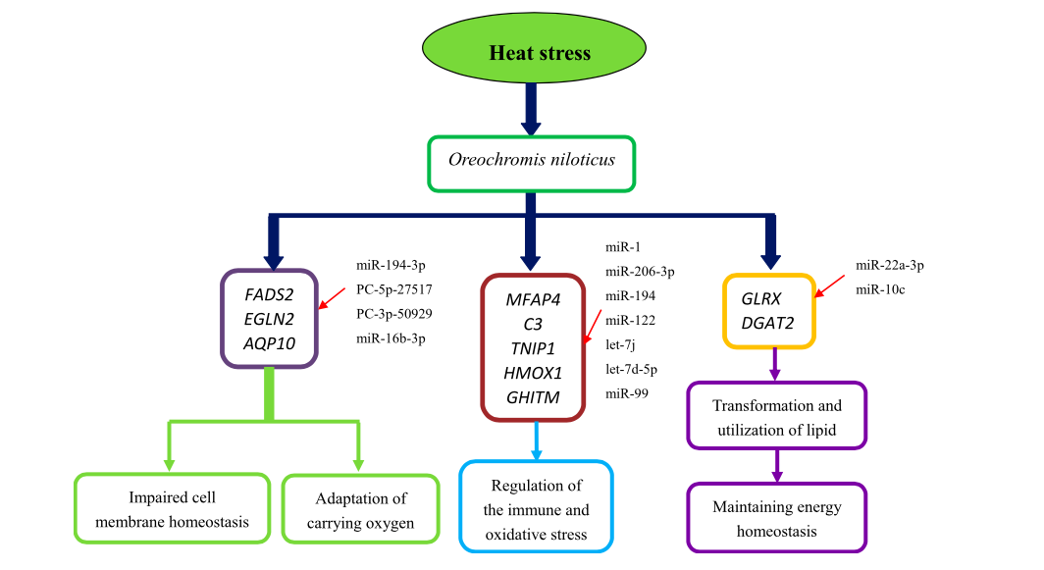
Figure 9: Diagram of regulated pathways in liver of GIFT exposures to 37.5ºC heat stressed for 24 h.

Slide 32
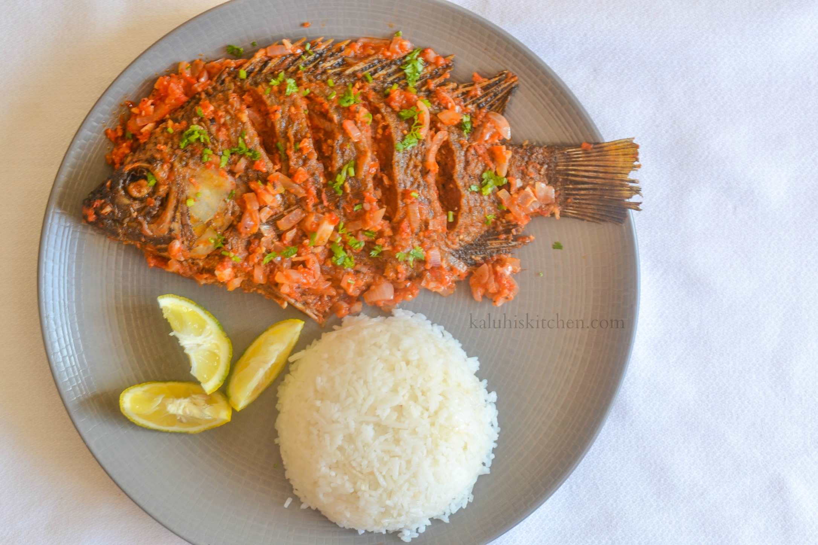
Thank you

