Slide 1
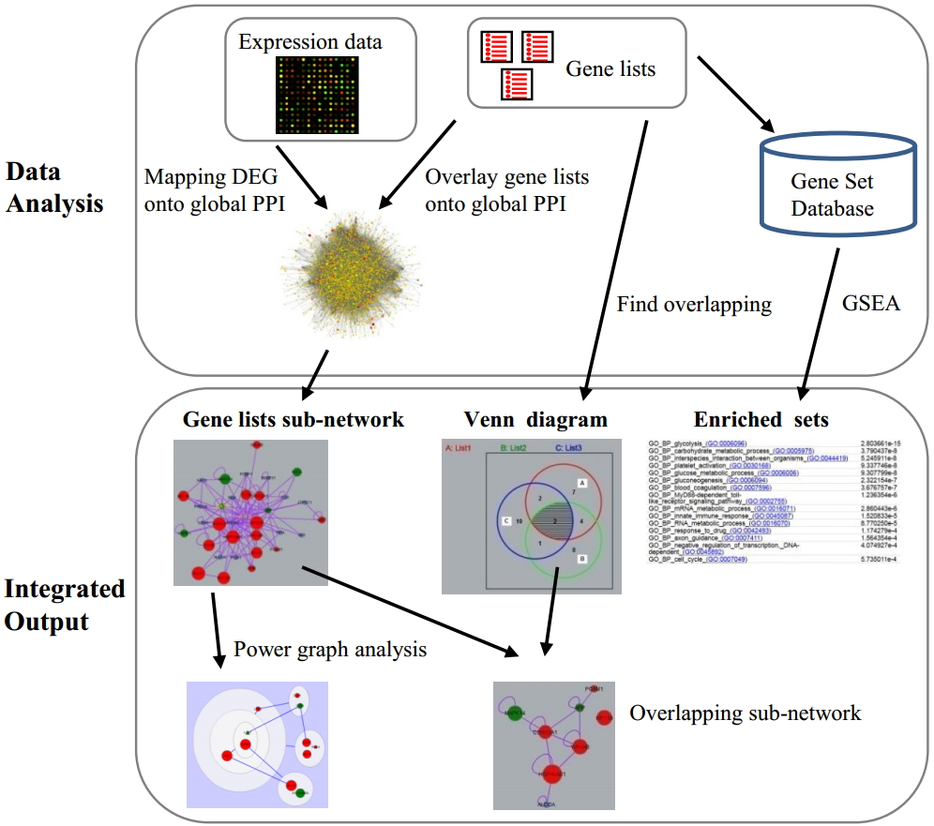
NetVenn
NetVenn is a network-based web platform for the comparison and analysis of gene lists by combining Venn diagram and gene set enrichment.
Input
Protein-protein interaction data to draw network
Network of input genes

Slide 2
How to use
1. Select the network data (zebrafish is not included)
2. Paste gene lists

Slide 3
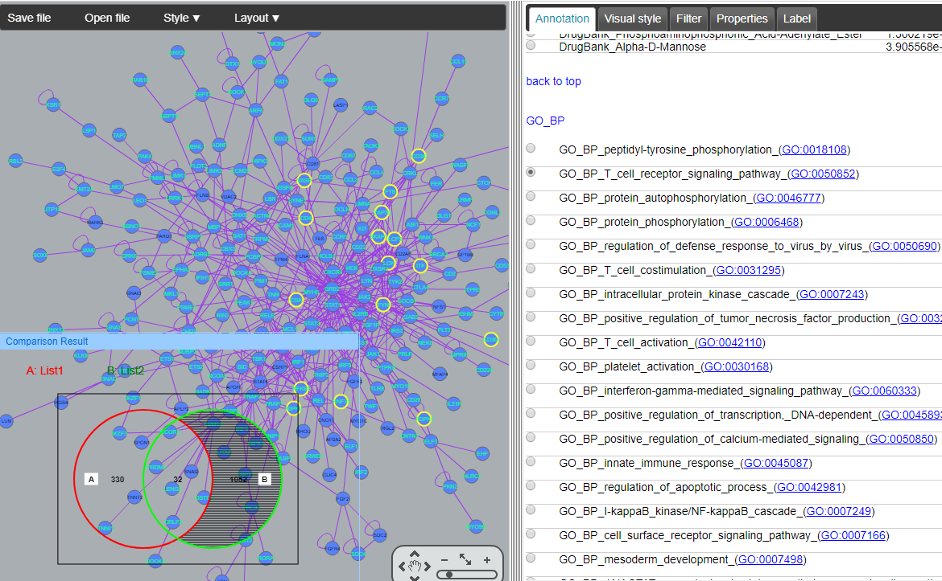
Result
Advantages:
- We can compare with two or more gene lists on the protein-protein interaction network with enrichment analysis.
HT up genes
HT down genes

Slide 4
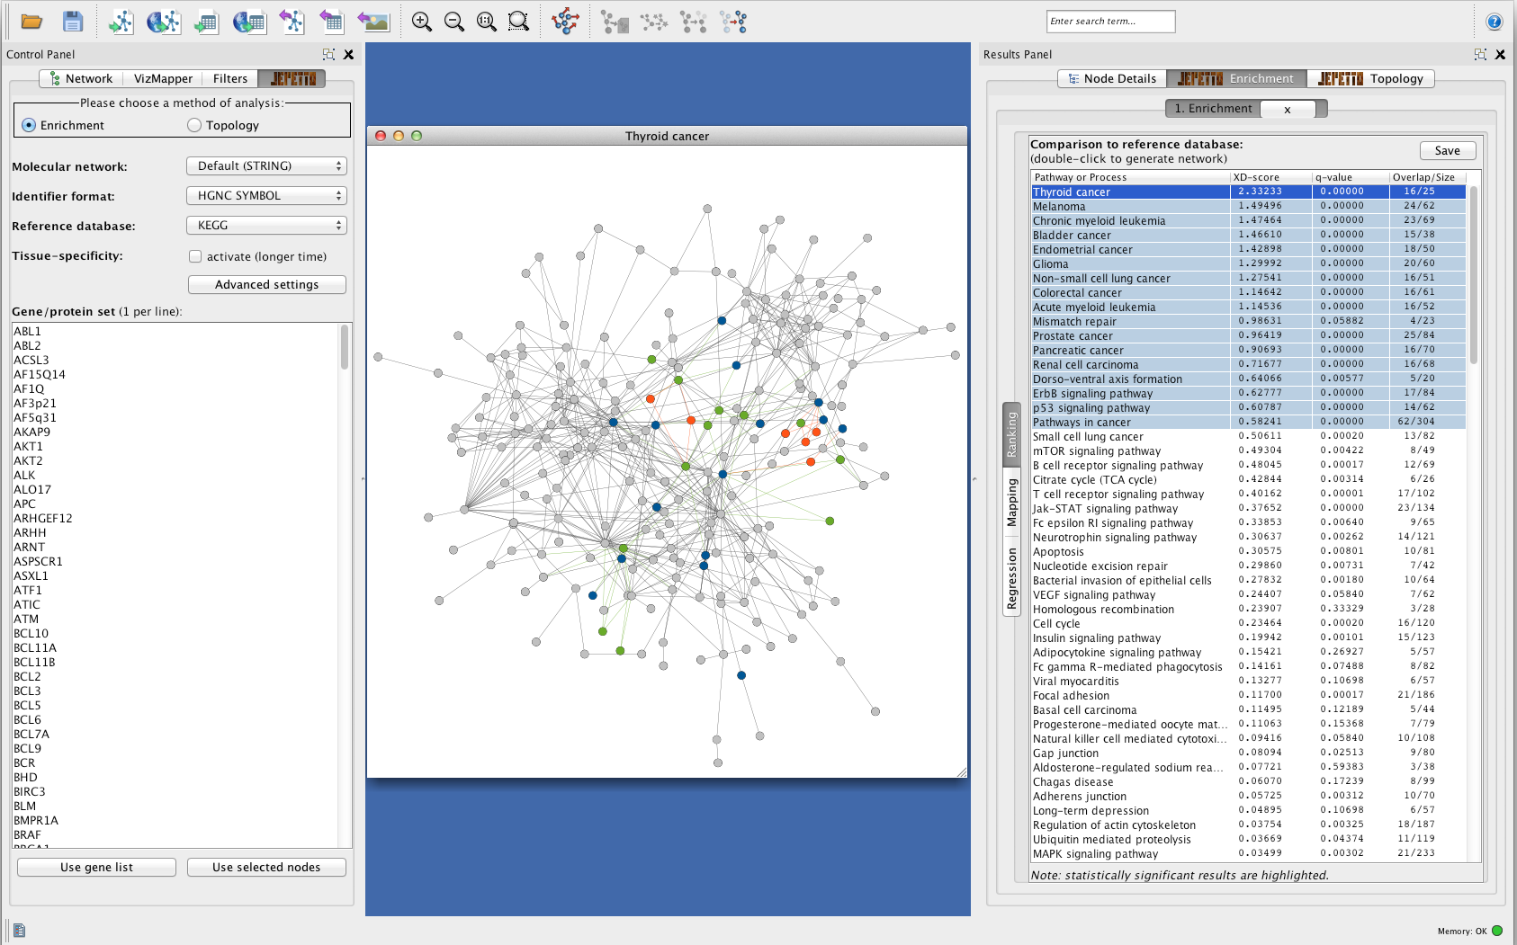
JEPETTO
Jepetto is a Cytoscape plugin. It performs integrated gene set analysis using information from protein-protein interaction (STRING database), KEGG pathways and processes databases.
Inputted genes on protein-protein interaction network
Input gene list
Result of enrichment analysis

Slide 5
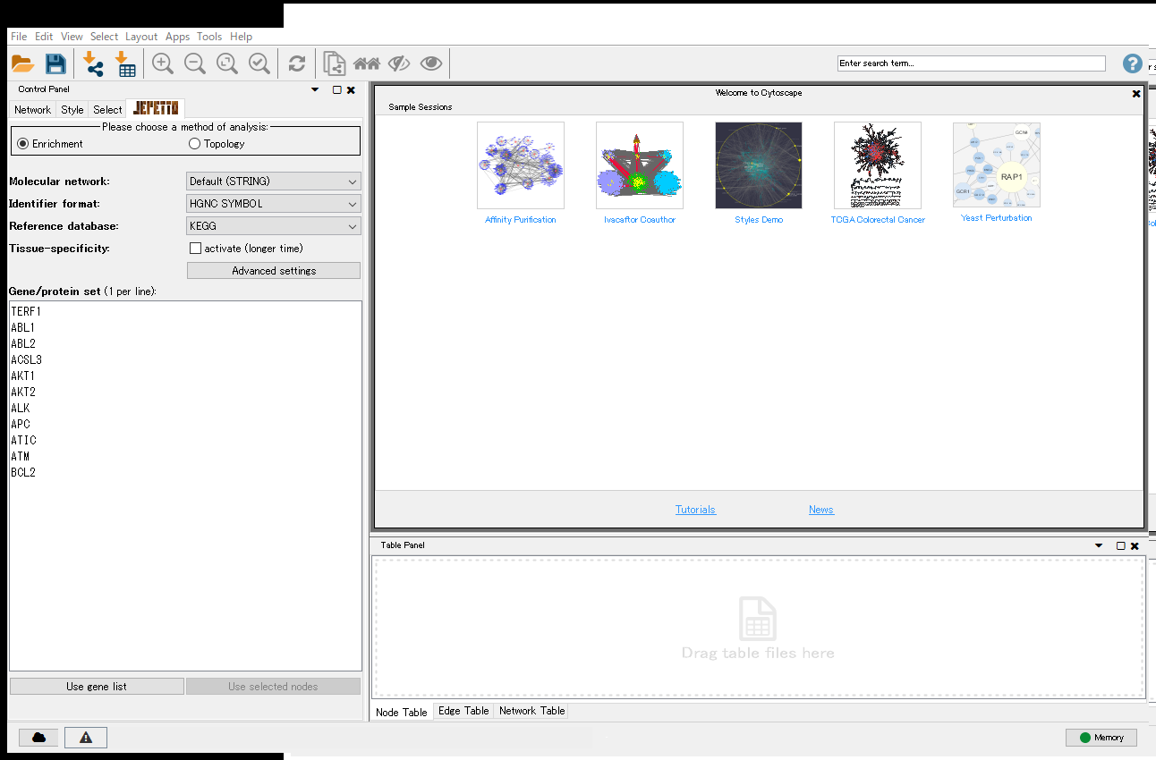
How to use
I could not use JEPETTO because following error occurred…

