Slide 1
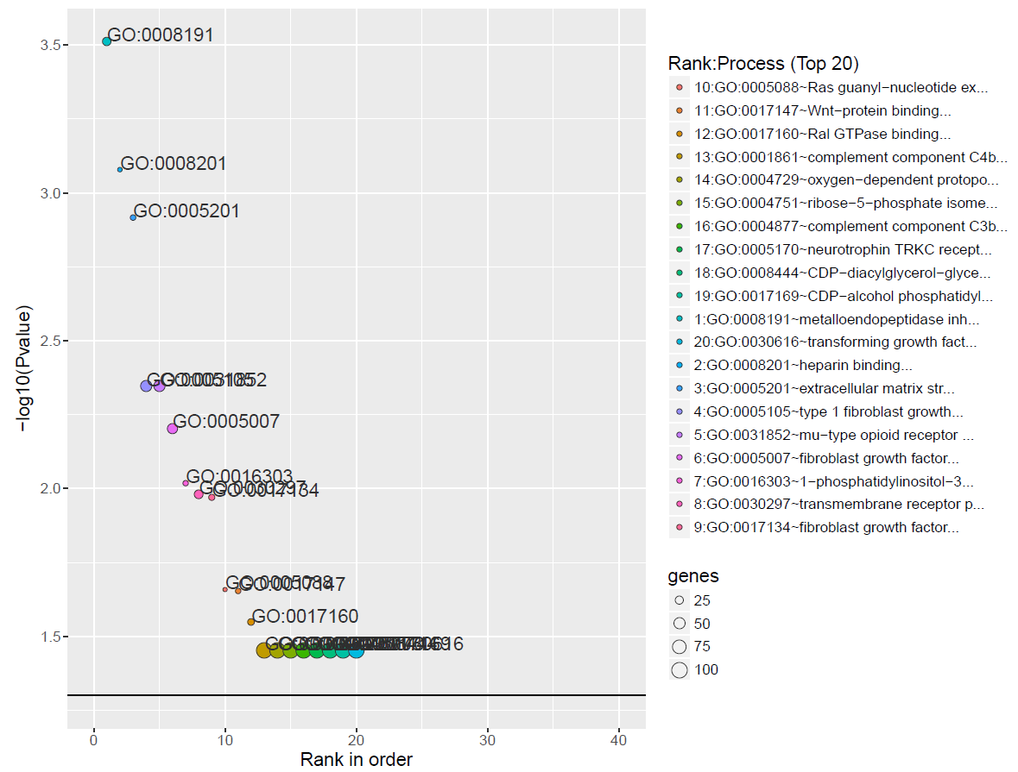
GeneSCF (Gene Set Clustering based on Functional annotation)
GeneSCF serves as command line tool for clustering the list of genes given by the users based on functional annotation (Geneontology, KEGG, REACTOME and NCG (cancer enrichment)).
Input files: gene list in the form of Entrez Gene ID (UIDs) or Official gene symbols
Results:
Advantages:
GeneSCF supports major databases (KEGG, Reactome, GO)
Enrichment analysis by the characteristic gene set from different cancer is unique.
I could get more significant categories than Enrichr.
Disadvantages:
It was a little troublesome to operate on the command line.

Slide 2
How to use
GO Molecular Function
geneSCF -m=normal -i=input.list -o=output/ -t=sym -db=GO_MF -bg=20000
--plot=yes -org=goa_human
GO Biological Process
geneSCF -m=normal -i=input.list -o=output/ -t=sym -db=GO_BP -bg=20000
--plot=yes -org=goa_human
KEGG
geneSCF -m=normal -i=input.list -o=output/ -t=sym -db=KEGG -bg=20000
--plot=yes -org=hsa

