Slide 1
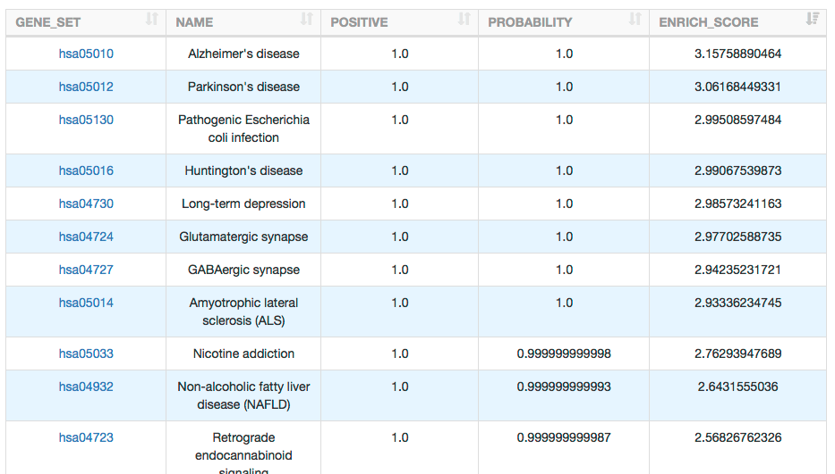
KOBAS (KEGG Orthology Based Annotation System) 3.0
KOBAS (KEGG Orthology Based Annotation System) is a web server for gene/protein functional annotation (Annotation module) and functional set enrichment (Enrichment module). Given a set of genes or protein, it can determine whether a pathway, disease, and Gene Ontology(GO) term shows statistically significant.
Input files: Gene ID list, DNA/protein sequences or Gene expression matrix table
Results:
Advantages:
- I could upload DNA/protein sequences for annotation, and I could easily use this site.
- KOBAS supports many databases (KEGG, Reactome, BioCyc, OMIM, GO, etc.)
Disadvantages:
- KOBAS supports only 7 species for background abundance calculation.

Slide 2
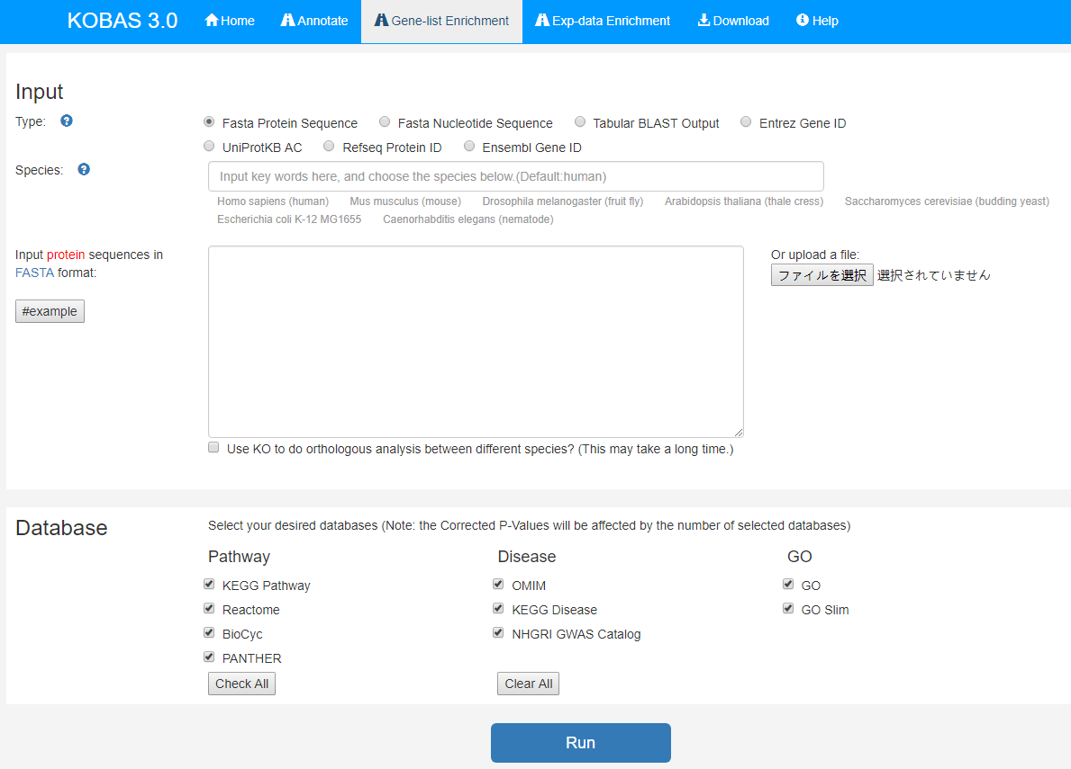
How to use
1
If your target is not in below list, “human” might be OK.
2
3
Upload your gene list or transcript sequences.
4

Slide 3
GSEA (Gene Set Enrichment Analysis) 3.0
Gene Set Enrichment Analysis (GSEA) is a computational method that determines whether an a priori defined set of genes shows statistically significant, concordant differences between two biological states (e.g. phenotypes).
Input files: tab-delimited txt file
phenotype label txt file
Results:
Advantages:
- GSEA supports many databases (KEGG, Reactome, BioCarta and customized gene sets such as immunologic signatures and oncogenic signatures)
- Not only gene name but also the expression value is considered to calculate significance.
Disadvantages:
- GSEA needs a tab-delimited text file with the row name as gene name, and it is some complicated process.
Other notes
- GSEA requires samples of two different conditions, but background group (such as human or mouse) is not needed.

Slide 4
How to use
1
3
2
Load a “Dataset” file and a “Phenotype labels” file
4
Set parameters
5

