Slide 1
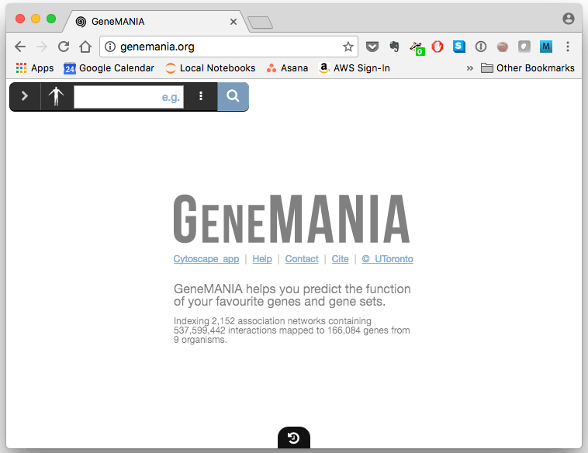
http://www.genemania.org
Mariom
20.12.2017

Slide 2
GeneMANIA
GeneMANIA is a flexible, user-friendly web interface for generating hypotheses about gene function, analyzing gene lists and prioritizing genes for functional assays.
It identifies the most related genes to a set of input genes, using a very large set of functional association data.
Association data include protein and genetic interactions, pathways, co-expression, co-localization and protein domain similarity.
How to use
Input files: prepare a list of the genes
(gene symbols or NCBI Gene IDs)
Ensure each gene identifier is on a separate line

Slide 3
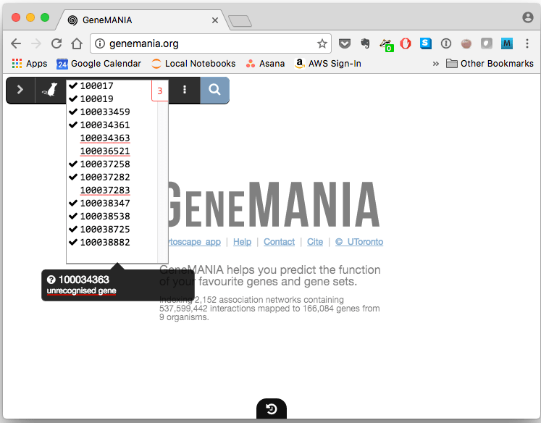
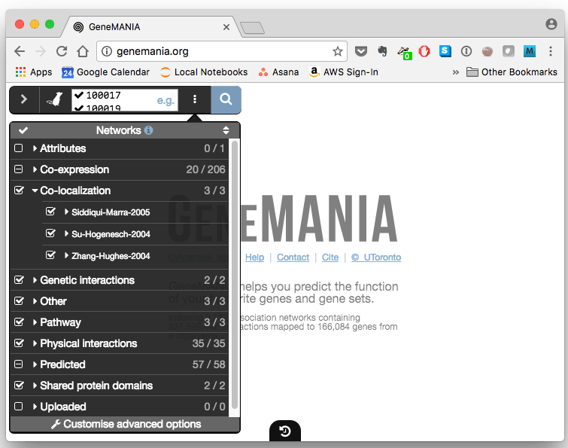
1
2
Paste the list of your gene of interest here
3
4
Click on the magnifying glass button to begin network creation
Any genes that cannot be found in GeneMANIA’s database will be highlighted in red
This displays all the interaction sources and allows you to select which should be included by checking their boxes
These genes will be ignored in the rest of the analysis

Slide 4
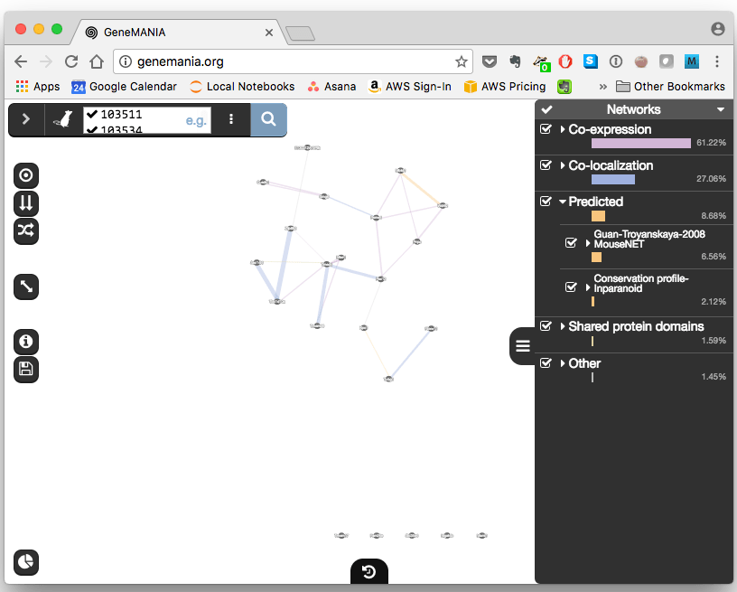
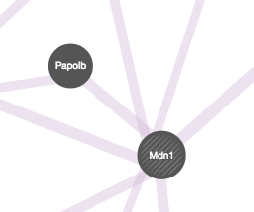
Results
The finished network will appear in the main screen. Genes with identified interactions will be connected
Different kinds of interactions are represented by different colored connector lines. You can select or deselect which interactions are displayed:
those without identified interactions will be shown in a row across the bottom of the screen
input genes are shown with cross-hatched circles of a uniform size, while those that were added as “relevant” genes by GeneMANIA are shown with solid circles whose size is proportional to the number of interactions they have

Slide 5
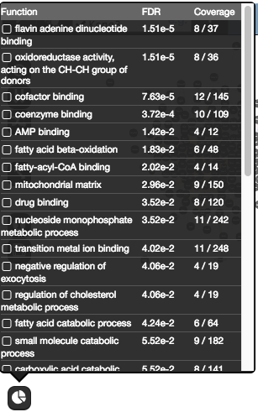
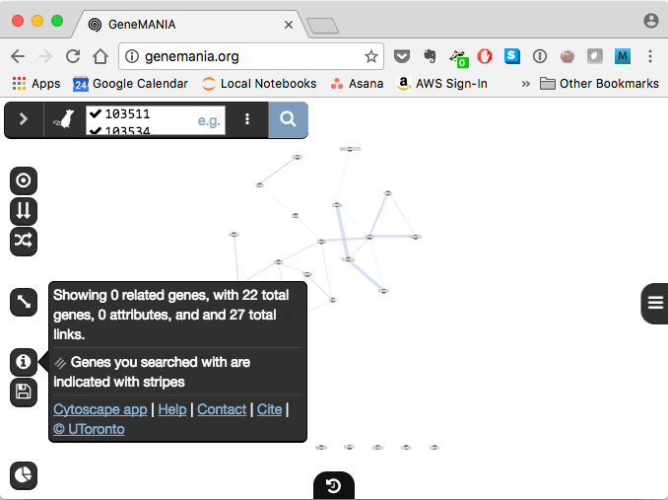
Mousing over a single gene’s circle highights only its interactions
shows basic information about the network, such as how many genes and interactions it includes

Slide 6
Advantages:
The high accuracy of prediction algorithm, and
large database make GeneMANIA a useful tool for any biologist.
Users can customize their search by selecting specific data sets to query and by uploading their own data sets to analyze.
Limitations:
Seven organisms are currently supported (Arabidopsis thaliana, Caenorhabditis elegans, Drosophila melanogaster, Mus musculus, Homo sapiens, Rattus norvegicus and Saccharomyces cerevisiae).

