Slide 1
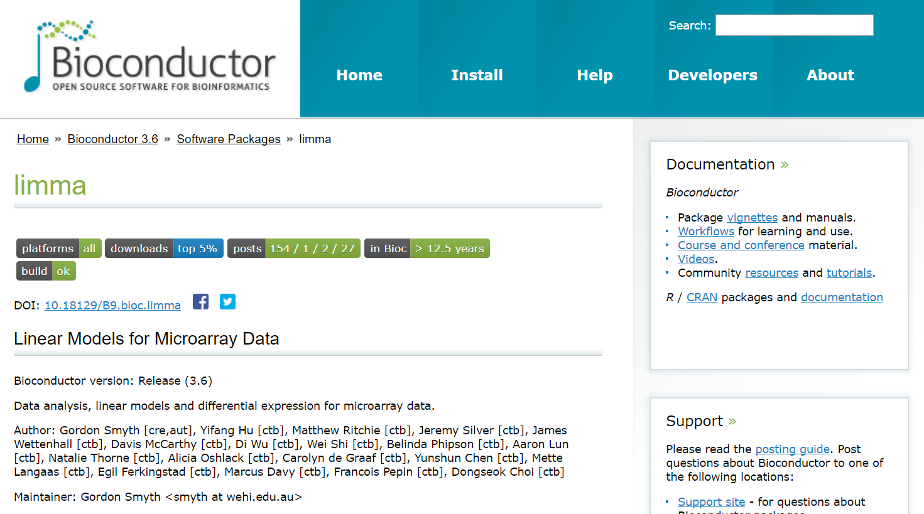
http://bioconductor.org/packages/release/bioc/html/limma.html
Prasadi De Silva
20-12-2017

Slide 2
Introduction
Provides an integrated solution for analysing data from gene expression experiments.
Can handle complex experimental designs and information borrowing to overcome the problem of small sample sizes.
Contains particularly strong facilities for reading, normalizing and exploring such data.
Advantages:
(i) it can perform both differential expression and differential splicing analyses of RNA-seq data;
(ii) analysing expression profiles in terms of co-regulated sets of genes or in terms of higher-order expression signatures. This provides enhanced possibilities for biological interpretation of gene expression differences.
Disadvantages:
(i) Inconvenient
(ii) Need good knowledge of R

Slide 3
How to use?

Slide 4
Output after installing limma:

